Slide 1


HR Symposium HR Symposium The Reference Check Roller Coaster Matt Mitchell & Lisa Coligan December 4, 2025

Slide 2

Centralization Impact
Current state: agencies created own internal policies and practices for handling reference checks. Differ from one another in content, depth, and legal risk.
Opportunity with centralization: Reference checks are the initial pilot topic for building consistent HR guidance. Standardize reference check process.
How Centralization can deliver: (i) build a unified best-practice model; (ii) understand current practices before standardizing; and (iii) establish a replicable framework.
2

Slide 3


Today’s Ride: Reference Check Dual Role Conundrum of Doom!
Using best practices to keep reference checks “on the tracks.”
Review and audit your current practices to ensure your agency has developed a consistent, defensible process for:
Conducting a reference check; and
How to respond when contacted as a reference.
3

Slide 4
Reference Check Dual Role Conundrum
Dual Role:
(1) one executive branch agency is “requesting” the reference, and
(2) the other executive branch agency is “responding” to the reference check.
Both agencies will have HR located in DOA under centralization.
Common strategy: neutral, confirm only dates of employment.
This risk avoidance strategy may help one agency avoid lawsuits but shifts the risk onto another agency.
The State Government issue: passing around problematic employees with records of formal discipline.
How to solve the Dual Role Conundrum: strike a balance for both the hiring agency and the responding.
4

Slide 5
Why do we care about reference checks?
Risk Management & Protecting the Agency
Decision Making
Special consideration for state government
5

Slide 6
Relevant Rules, Policies, & Laws
Montana Operations Manual (MOM) Recruitment and Selection Policy
ARM 2.21.3726(4) “applicant information” includes…reference checks.
ARM 2.21.3728(3) “applicant information” is considered confidential to third parties unless an exception applies like a court order or release from the applicant.
ARM 2.21.6615 and 6616: an “authorized user” can rely on the contents of employee personnel records when responding to request for employment information.
Montana Blacklisting laws MCA 39-2-801 through 804
Defamation and qualified privilege MCA 27-1-801 through 804.
Agency specific policy, guide, or reference check form
6

Slide 7
When the Reference Check Goes “Off the Tracks”
How reference checks become lawsuits
Speculate, exaggerate, subjective opinions, inconsistent practices
Common types of claims:
Defamation / negligent misrepresentation
Discrimination and retaliation
Negligent hiring or retention
Practice tip: think -- if what I say in the reference is shared with the applicant, would I feel comfortable that it is accurate and supported by documentation.
Examples – how something that feels small, casual comment, a favor for a former employee, or a shortcut in the process – can lead to costly/lengthy litigation involving hearings, discovery, and depositions.
7

Slide 8
Scenario #1
Agency A conducts a sexual harassment investigation and finds there was a “credible complaint and policy-violation of inappropriate conduct toward a coworker but did not rise to sexual harassment under policy.” The policy violation justified discipline and Agency A issued a due process letter.
Prior to the discipline being issued, the employee resigns from Agency A.
Later, the employee applies for a job at Agency B. During the reference check, the supervisor at Agency A casually explains “we fired the employee for sexually harassing a coworker.”
Agency B does not hire the employee, and the employee finds out that agency A said he “sexually harassed” an employee and that is why he was fired.
Agency A misrepresented what occurred. Agency A found a policy violation, but not sexual harassment. Also, discipline had not been issued. Labeling the employee as someone that committed “sexual harassment” and was fired are materially different facts and carry more reputational harm.
Types of claims: defamation, negligent or intentional misrepresentation, emotional distress
What if Agency A had actually fired the employee? “subtle distinction”
Takeaway: Agency A had a defensible documented reason to explain to Agency B but misrepresented the information into a potentially actionable legal claim.
8

Slide 9
Scenario #2
Agency A has a reference policy to only confirm dates of employment and job titles. The manager at agency A receives a reference call from agency B about an employee named Jane. Wanting to show his appreciation for all Jane’s hard work, the manager gives a detailed highly favorable reference. Jane gets the job, and word circulates that manager gave her a glowing reference.
Months later, another agency A employee, John, applies for a position at agency B. John had recently filed an internal discrimination complaint against agency A involving a claim disability discrimination. Agency B calls the manager to get a reference. This time, the manager refuses to provide any substantive information and complies with company policy by only confirming dates of employment and job title.
John learns the manager gave Jane a strong reference but refused to do the same for him. John files a retaliation and disparate treatment claim, alleging the refusal was motivated by John’s protected status and prior complaint.
Takeaway: the inconsistent application of the policy created the risk. Even if you think you are giving a good reference “as a favor” can be used as a basis in a discrimination claim.
9

Slide 10
Solving the Dual Role Conundrum
Best practice ideas for:
Performing reference checks between state agencies; and
Responding to reference checks between state agencies.
10

Slide 11
Conducting Reference Checks: Best Practice
Recommended process for agency-to-agency reference check.
Step 1 Determine who should conduct the reference check
HR or trained supervisor.
Prohibit untrained staff from conducting reference checks.
Same person should conduct all reference checks.
11

Slide 12
Conducting Reference Checks: Best Practice
Step 2 Determine the timing of the reference check and how many
Done prior to offer on final candidate(s).
After conditional offer in rare circumstances (consult w/ legal).
Weigh the risks.
Candidate will be much more interested in impact of references.
Limits the explanation you can provide if offer is withdrawn.
Step 3 Who to Contact First:
If current/former state employee, contact the agency HR at candidate’s current or former agency.
References the candidate provides.
Ask for references who can speak to the candidate’s job responsibilities and performance.
12

Slide 13
Conducting Reference Checks: Best Practice
Step 4 Notification and Authorization (Transparency)
Prior to calling candidate’s agency HR, inform candidate of who you intend to contact.
Written consent form is best practice.
Review your job posting and application (consider including notice of reference checks in job postings).
Provide candidate opportunity to inform current employer.
No “secret” reference checks.
13

Slide 14
Conducting Reference Checks: Best Practice
Step 4 (cont.) Written Consent Form Example
Thank you for your continued interest in the [position title] role with [agency/dept.]. As part of our reference check process for final candidates, we contact the HR office at your current or former Montana state agency to verify your employment history, job performance, and other job-related information relevant to this position. Please reply to this email confirming your authorization for me to contact the HR office at [agency name] and obtain information relating to your job performance, duties, dates of employment, and eligibility for rehire. All information will be used strictly for the purposes of evaluating your suitability for employment.
14

Slide 15
Conducting Reference Checks: Best Practice
Step 5 Prepare the reference questions
Confirm reference name, role, and working relationship with the candidate.
What else to ask?
Ask about positions held, dates of employment, promotions, job duties, performance, attendance records.
Ask about skills relevant to the position, such as the candidate’s leadership, relationship building, analytical, or teamwork skills.
Ask why the candidate left and if the candidate is eligible for rehire.
Ask all references the same questions.
15

Slide 16
Conducting Reference Checks: Best Practice
Step 5 (cont.) What NOT to ask
Cannot ask about disability, ADA, protected class (Title VII).
Avoid subjective, opinion, and leading questions.
Step 6 How to contact and document the reference
Phone or Teams.
Document the reference check – reference info, questions asked, responses.
Avoid documenting subjective, protected, or non-job-related information.
Prepare to redirect the reference, as necessary.
16

Slide 17
Conducting Reference Checks: Best Practice
Step 7 Evaluate the reference information
Red flags.
Inconsistency between resume or interview responses and reference information.
Job performance issues.
Consider relevance of job performance information or termination reason to the current position.
For example, termination for not achieving or maintaining a license may not be relevant.
May be appropriate to follow up with candidate – especially for probation terminations.
17

Slide 18
Called as a Reference: Centralization Best Practice
Recommended process for agency-to-agency reference calls
Step 1 When another agency is calling for a reference check, the first reference contact should be HR.
If the call comes to a supervisor first, redirect to HR.
Step 2 Identify and train who is allowed to respond.
HR or trained supervisors.
Responders should have direct knowledge of the candidate.
Reference calls to untrained staff and/or or staff without direct knowledge should be directed to HR.
18

Slide 19
Called as a Reference: Centralization Best Practice
Step 3 Verify the request and the requestor
Current or former employee.
Another state agency or outside employer.
Title and role of requestor.
19

Slide 20
Called as a Reference: Centralization Best Practice
Step 4 Notice and authorization
Ask if the candidate provided consent for the reference to contact you
Request a copy of the consent form.
Ask for authorization if it hasn’t been provided.
Prohibit informal or “secret” reference checks.
Step 5 Pull and review the personnel file
Walk through potential responses before providing information.
Review bargaining agreement requirements, if applicable.
20

Slide 21
Called as a Reference: Centralization Best Practice
Step 6 Responses
Be honest and factual.
Give minimum details instead of providing lengthy explanations.
Responses should be supported with documentation.
For example, documented formal discipline in the personnel file.
Handle negative information carefully.
“The performance history indicates this candidate had issues with timeliness.”
“This candidate was terminated for cause for not adhering to attendance policies.”
21

Slide 22
Called as a Reference: Centralization Best Practice
Step 6 (cont.) Responses DONT’S
Do not provide information about disability, ADA, protected class (Title VII).
Prohibit sharing information about grievances, or claims filed (retaliation).
Avoid subjective information and hearsay,
Do not provide information that is not supported by documentation.
Do not say: “I never worked with him, but I heard candidate is always condescending.”
22

Slide 23
Called as a Reference: Centralization Best Practice
Step 7 Document the reference
Requestor, candidate, questions asked, and information provided.
Step 8 Train staff and reinforce boundaries
Regularly review reference practices.
Follow-up and address noncompliant practices.
23

Slide 24
Reference Checks: Best Practice Outside Employer
Recommended process for outside employers
Providing a reference
Confirm dates of employment and job titles – just the basics.
May consider providing more information if receive candidate release (consult with legal).
Contacting a reference
Similar process as when contacting a state agency.
If receive only dates of employment and job title – ask if that is standard company policy.
24

Slide 25
One-off questions and issues
Union employee – check CBA, is the discipline still within the CBA timeline.
Settlement neutral reference (consult legal).
Challenging employee with no history of formal discipline in the personnel file – how to respond to reference.
What to do if a reference discloses something like (medical, ADA).
Applicant does not get the job and requests “applicant information.”
Applicant does not want you to call current employer (hasn’t notified them yet).
25

Slide 26
Important Takeaways
Perform reference checks.
Be structured and consistent.
Provide factual information supported by documentation.
26

Slide 27
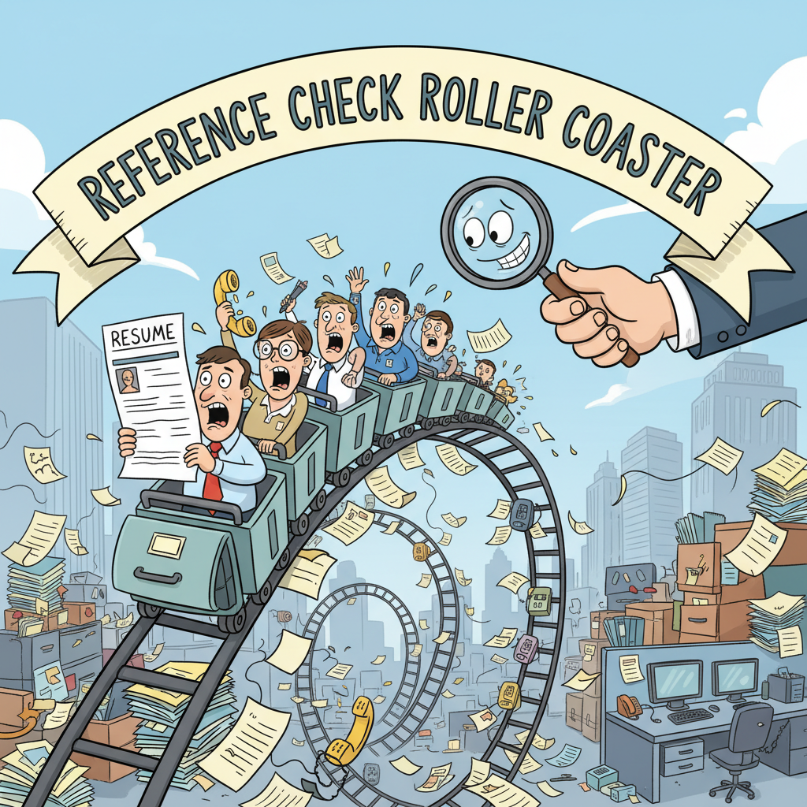
Questions?
27

