Slide 1


HIRE SKILLS
Skills-based approach to hiring

Slide 2
THE SKILLS FIRST APPROACH
Focus on what people can do – their demonstrated skills – rather than relying solely on the traditional markers like degrees, past employers, years of experience, or job title
Education and experience still matter
Key is not how the skill was learned but whether they can demonstrate it to you
Not lowering the bar but moving the bar to where performance actually happens

Slide 3

WHY SKILLS-BASED?
Expanded talent pool and internal mobility.
Expands access to opportunity and promotes equity.
Helps close skills gaps faster and increase productivity.
Increases workforce agility, resilience and sparks innovation.
Improves retention by offering clearer growth paths.

Slide 4
EXECUTIVE ORDER NO. 5-2025 – 406 JOBS
“The Department of Administration shall support state agencies in advancing a skilled and resilient workforce by…promoting and facilitating the adoption of skills-based hiring practices where feasible to expand access to qualified talent and support equitable hiring”

Slide 5
WHAT IS A SKILL?
Durable, Power, or Soft skills
Transferable skills
Technical or hard skills

Slide 6
SKILLS TERMS
Skills mapping – skills applied to roles
Skills inventory – existing skills in organization
Skills gap – role needs missing from existing population
Upskilling – develop existing talent to do existing role better
Reskilling – develop existing talent to do a new role
Skill assessments – evaluate an employee/candidate’s skills
Skills taxonomy – organizes skills into categories, unified language

Slide 7
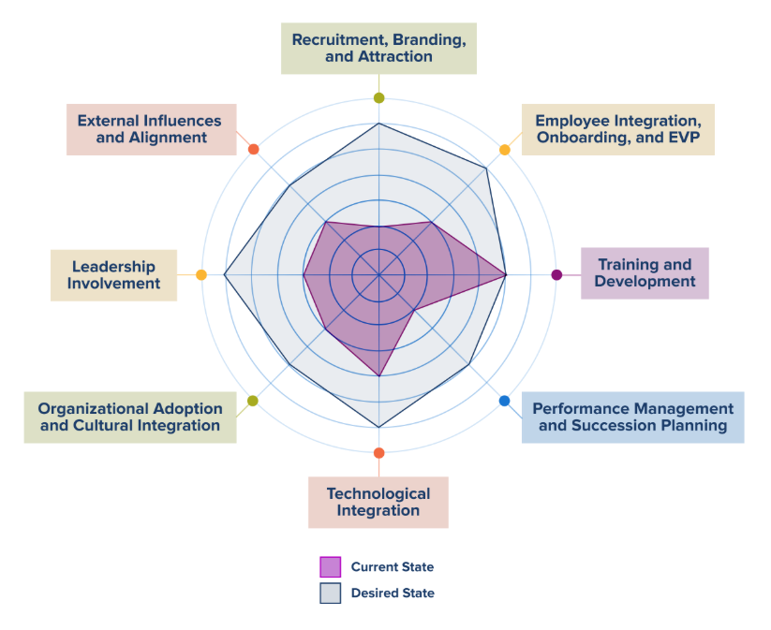
SHRM SKILLS FIRST GROWTH MODEL
All aspects of employee lifecycle within organization are impacted
Interconnected, not linear
8 vectors with 19 associated indicators

Slide 8
TALENT ACQUISITION
Attracting and hiring skills-first talent
STARs = Skilled Through Alternate Routes
Key Concepts in Skills-First Hiring
Employee Value Propositions (EVPs), Job Descriptions, and Postings
Sourcing, Screening, and Scheduling Interviews
Interviewing, Hiring, and Pre-Boarding
Continually Reviewing and Improving
Benefits
Better Access to Talent
Better-Fitting Candidates

Slide 9
TALENT DEVELOPMENT
The growth engine
Upskilling and continuous learning
Structure learning
Mentorship
Career pathways

Slide 10

TALENT MANAGEMENT
The overarching strategy and systems that drive organizational success.
Talent management systems
Skills-first career frameworks
Data-driven decision making
Highlight business value

Slide 11
HR AS A CHANGE AGENT
Take the lead
develop the skills-first vision, working with leadership to define goals and objectives for shifting to skills, and aligns the company's talent strategy
Conducts research and analysis to create a business case
Predicts ROI, cost savings, and expected business outcomes
Communicates the benefits to stakeholders to address concerns and get buy-in
Helps manage hiring process changes
Spearheads communication and implementation

Slide 12
IT’S A JOURNEY
Identify
Specific challenge for the business that is strategic, compelling, and manageable
Involve
Who needs to be a part of your change process and in what way
Iterate
Create change one experiment at a time
Integrate
Celebrate success and continuous development

Slide 13
CURRENT STATE
Behavioral/situational interviewing
‘STAR’ method
Other combinations of education and experience
RFP for new ATS will ask about skills-based features

Slide 14
EMPLOYEE VALUE PROPOSITION
Essential for attracting and retaining top talent
This is your “why.” You are communicating your organization's mission, values, and what it offers to employees.
Go beyond the basics (salary, health insurance, retirement):
Highlight opportunities for growth and development
Emphasize the impact employees can make
Communicate the benefits of a skills-first organization
Resonate with individuals who are driven by continuous learning

Slide 15
JOB DESCRIPTIONS IN POSTINGS
Company Information
Use concise, straightforward language, and active verbs
Avoid industry jargon and any specialized terms
Keep this section short—no more than a few sentences
Interested candidates can find more information on the company website
Essential Job Details
Provide a clear, basic understanding of the position and how it fits in the company
Job Summary
Make interested to learn more
Skills, Knowledge, and Expertise
Don’t be vague—be precise
Be sure the skills can be demonstrated
Prioritize the day one skills
Avoid phrases like ‘experience’ or ‘years of experience required’

Slide 16
SCREENING
Use ‘Day One Skills’ – core skills required to succeed in role with minimal training
Tools:
Application questions
Assessments

Slide 17
ASSESSMENTS
Do
Align assessments with skills required for success on day one.
Test for relevant on-the-job applications.
Partner with hiring managers to ensure alignment and get their input on format and timing.
Evaluate tools and assignments for potential bias.
Don't
Assess too many skills at once.
Rely on just one assessment type.
Use overly complex assessments.
Skip post-assessment discussions.

Slide 18
INTERVIEW QUESTIONS
May take slightly longer initially, lead to significantly better outcomes in the long run.
Benefits: More Effective Evaluation, Bias Reduction, Access to a Wider Talent Pool, Better Role Fit
Methods: Behavioral Questions, Scenario-Based Questions, Skills-First Assessments
Steps: Identify Essential (Measurable) Skills, Develop Standardized Questions, Ensure Interviewer Alignment, Review and Update

Slide 19
DATA DRIVEN
Make a plan for data collection
Capture before and after implementation
Be thoughtful and purposeful, align with business goals
Key metrics:
Number and percentage of job postings that don't require a four-year degree.
Number of qualified applicants
Number and percentage of new hires without a degree.
Time-to-hire
Cost-per-hire
Retention rates
Employee engagement scores

Slide 20
POSTINGS
Traditional
Skills-Based
Often rely on generic templates, lack personality, and focus on overly rigid, one-size-fits-all requirements rather than opportunities for growth
May use language that unintentionally excludes certain groups, missing out on a wider pool of qualified candidates
Compelling language and storytelling to highlight exciting aspects of the role and culture
Clearly emphasize essential skills needed for the role, using specific examples and keywords that candidates might search for
Inclusive language that welcomes people of all backgrounds and abilities reflecting commitment to merit-based advancement

Slide 21
REFRAME QUALIFICATIONS
Traditional Qualifications:
Bachelor’s degree in business administration, project management, or related field.
Five years of experience as a business analyst or related work.
Other combinations of education or experience may be substituted.
Skills-First Qualifications:
To thrive in this role from day one, you should demonstrate the following:
Skill in training diverse audiences on business systems and processes, with the ability to clearly explain complex information to non-technical users.
Proficiency in building strong relationships, actively listening, and measuring the impact of initiatives to ensure alignment with stakeholder needs.
Experience in assessing current-state operations, identifying improvement opportunities, and delivering effective, results-driven solutions.
Working knowledge of how learning management, talent management, and applicant tracking systems support organizational goals.
Ability to quickly learn and adapt to technical concepts, including infrastructure and related systems.
If you have a combination of the skills listed and a willingness to learn and deliver excellent customer service, we encourage you to apply.

Slide 22
ASK YOURSELF
Did you use any non-skills-first terms like “experience” or “years of experience?”
Did you use any industry jargon/specialized terms?
Are any of the skills or responsibilities vague or confusing?
Is the language concise and direct as opposed to long-winded and passive?
Have you narrowed your lists to five key responsibilities that the candidate will need on day one?
Are your five key responsibilities clear, distinct, and concrete?
For example, “managing people” is vague; “working with and motivating a team of seven to 10 programmers” provides more detail.
Did you list at least one skill/ability for each responsibility?
Do you have too many skills and abilities for any responsibility?
Hint: If you have three or more, there are probably too many to include in a job description.
Do the skills and abilities effectively match the key responsibilities?
Hint: If you can fulfill the responsibilities without one of the skills or abilities listed, it probably doesn’t belong.

Slide 23
KEY TAKEAWAYS
Requires a shift in mindset
Progress not perfection, start with small manageable steps
Continually refine and update

Slide 24
LET’S CONNECT
Heidi Greenback, Senior HR Generalist
SHRM Skills First Credentialed
Heidi.greenback2@mt.gov, Teams, or 444-0143

