Slide 1


2025 Human Resources Symposium
December 4, 2025

Slide 2
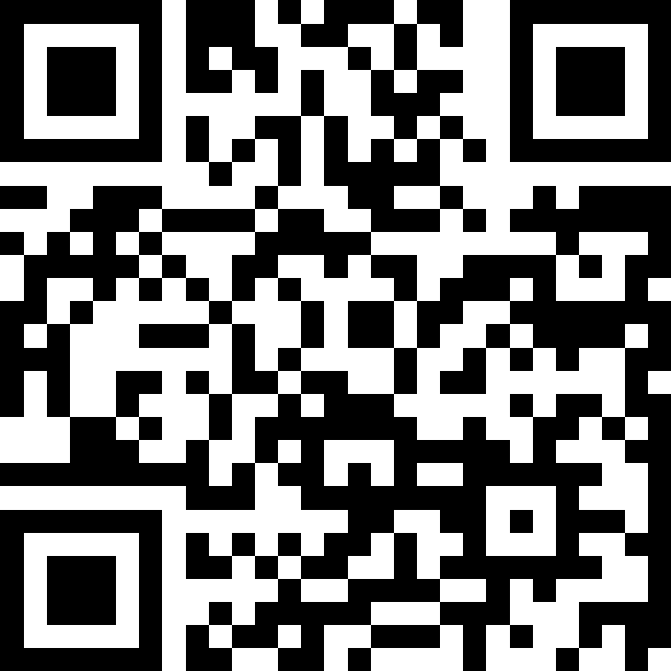

WHAT WORD COMES TO MIND?
AGENCIES WITH
NO PROCUREMENT
STAFF
MCC
MLOT
MPERA
MSL
OPD
PSC
TRS
Join at:
Slido.com
#4179176
2

Slide 3
Centralization Discussion
December 4, 2025

Slide 4
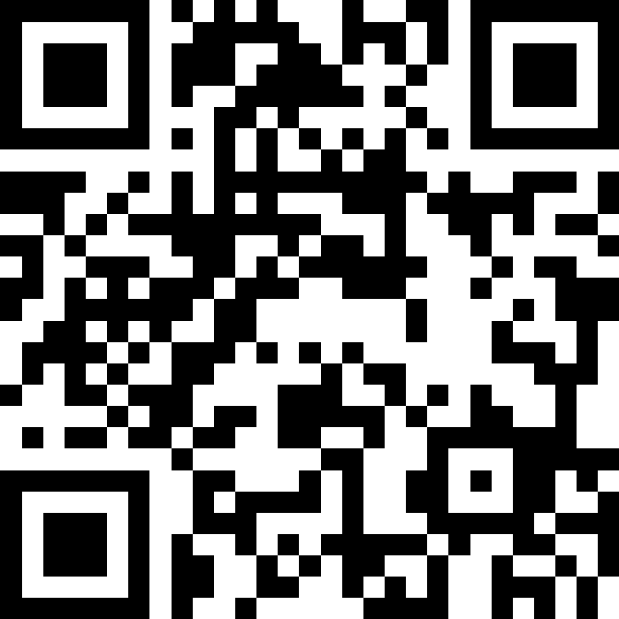
Q&A: WHAT QUESTIONS DO YOU HAVE?
AGENCIES WITH
NO PROCUREMENT
STAFF
MCC
MLOT
MPERA
MSL
OPD
PSC
TRS
Join at:
Slido.com
#4060016
4
Notes:
Questions captured so we can ensure they make it to the FAQs

Slide 5
BENEFITS OF CENTRALIZATION
  Empowered HR Teams: Enhanced support and resources enabling HR professionals to focus on strategic initiatives.
  Unified Collaboration: Seamless cross-agency knowledge sharing and adoption of best practices.
  Professional Development: Enterprise-wide training and development opportunities strengthening HR capabilities across the enterprise.
  Consistent Employee Experience: Standardized HR practices and messaging ensuring equitable employee experiences across all agencies.
  Operational Efficiency: Centralized policies, procedures, and tools reducing administrative burden on agency HR and freeing capacity for high-impact strategic work.
  Data-Driven Decision Making: Integrated HR systems and processes delivering reliable workforce data and real-time insights to support better organizational decisions.
5

Slide 6
SHRD STATUTORY RESPONSIBILITES
Mont. Code Ann. § 2-18-101 et seq.
These statutes assign the Department of Administration statewide leadership and authority over key HR functions for state government.​
Lead development of effective personnel administration practices for all state agencies and make HR expertise and resources available to them.​
Apply and carry out the personnel statutes under Mont. Code Ann. Title 2, ch. 18, pts. 1–3, including any actions needed to fulfill their purposes.​
Develop and issue statewide personnel policies.
Develop and foster programs for recruitment, selection, training, safety, health, counseling, discipline, grievance handling, performance evaluation, and retention of employees.​
Develop model rules of conduct for all state employees based on the state ethics laws (Mont. Code Ann. Title 2, ch. 2).
Investigate how personnel statutes and policies are working in practice and report findings and recommendations to the governor.​
6

Slide 7
HR CENTRALIZATION / TIMELINE
August - October
  Agency Deep Dive Meetings
  Note: Agencies that are hiring human resource/payroll staff MUST include DOA in those interviews and hiring actions.
November - December
Share Centralization Structure/Model with Agency Directors and Staff
2026
January - February
Partner with OBPP on funding structure for the remainder of FY25/FY26
Initiate Reporting Structure
March
  Continue to refine structure as needed to ensure efficient operations
  Develop rate structure for FY28/FY29 budget
April-July
HR employees reported by DOA to OBPP for snapshot
August 2025 July 2026
7
7
Notes:
Beginning to Partner with OBPP now, finalizing the position mapping and funding data to provide to them.
Reporting structure will be initiated with volunteers first, towards late January/early February
All positions need to be in place for snapshot in July

Slide 8
DISCOVERY

Slide 9
DISCOVERY DETAILS
100 DATA POINTS
15 AGENCY DISCOVERY SESSIONS
5 SHRD FOCUS GROUPS
3 STATES
9
Notes:
Gathered data, existing assessments, and other relevant information during a comprehensive data-call at the start of the project, including:
Agency-Specific Policies
Annual Employee Engagement Survey Responses
Compensation Metrics
Classification Metrics
Discovery Session Notes
HR Transactional Volumes
Recruitment Metrics
Pay Adjustment Data
SHRD hosted 15 Discovery Sessions with cabinet agencies to discuss current HR practices and centralization concerns.
Facilitated interview and focus groups with the SHRD Administrator, Deputy Administrator, Attorney, and SHRD Managers to discuss opportunities for improving HR service delivery & operations.
SHRD met with three other states that have underwent centralization to discuss their experiences: Alaska, Michigan, and Wisconsin

Slide 10




HR CENTRALIZATION: CURRENT STATE SUMMARY
PEOPLE
  Current HR agency staff primarily operate in siloes, which has led to limited knowledge sharing and limited standardization in HR operations.
  HR Staff are developed through a mix of in-house training, peer support, and external resources, but agencies noted inconsistencies with access to professional development opportunities.
  Agencies described ongoing staffing challenges, including seasonal fluctuations and high turnover, which currently places additional pressure on HR teams – particularly those with smaller staffs.
PROCESS / POLICY
  Limited process standardization exists across the agencies – HR staff follow the precedence established in their individual agencies, and limited sharing of best practices occurs across the agencies.
  Many agencies follow more manual processes for key HR functions, which highlights the need for greater consistency and automation.
  Policies are not always standard from agency to agency, as policy governance is difficult to enforce with the current org structure and SHRD team bandwidth.
  TECHNOLOGY
  Agencies use a variety of HR tools (including “homegrown” solutions), as to-date, they have been acting autonomously in their technology selection. Integration across tools and platforms remains a challenge
  Agencies are in various states of migrating to digital record-keeping, but few use digital solutions that are more sophisticated than a centralized shared drive.
  Concerns exist about maintaining data integrity and consistency, particularly as agencies juggle multiple platforms and legacy systems.
10
Notes:
Agencies each have a one pager they reviewed summarizing their specific discovery session.
Opportunities for Enhancement:
Resource Constraints Limit Strategic HR Initiatives
Inconsistent Policy Governance Across Agencies
Siloed HR Support Creates Service Inefficiencies
Fragmented HR Technology Hampers Oversight - Homegrown in addition to or in place of enterprise systems
Uneven HR-to-Staff Ratios Challenge Capacity Building
Lack of Standardized Processes Hamper Engagement with SHRD

Slide 11
HR CENTRALIZATION UPDATES
STATE DISCOVERY
Met with the following states to learn more about their human resources centralization journey:
Alaska
Michigan
Wisconsin
THEMES FROM THESE DISCUSSIONS:
Define and communicate clear roles and reporting relationships, so HR staff and agency personnel know when centralized protocols apply and when there’s room for agency-specific flexibility.
Use service-level agreements or MOUs to set expectations regarding decision-making authority and escalation expectations.
Change management is key. Focus on transparent communication and providing feedback channels.
Allowed for specialization across HR functions. Dedicated teams enabled the development of subject matter expertise and scalable learning/development programs, improving overall service quality.
Enabled better compliance with employment law, more consistent application of benefits, and improved workforce planning across agencies.
Standardization should start with transactional processes, followed by a broad transformational plan tailored to the state’s specific needs.
11

Slide 12
FUTURE VISIONING

Slide 13
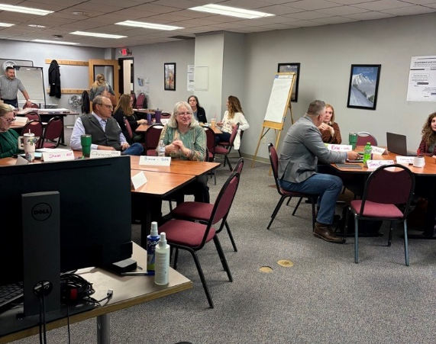
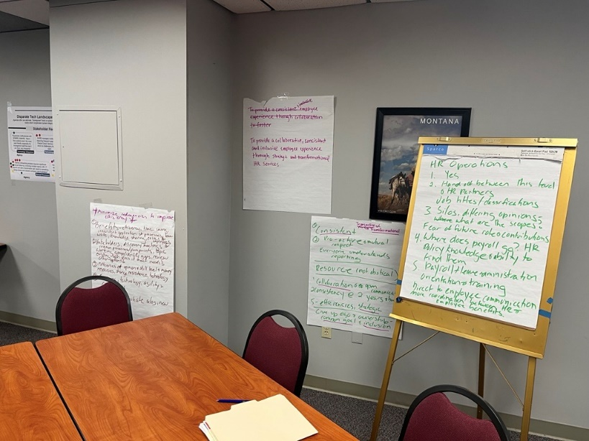
FUTURE STATE HR VISIONING LAB
To collaboratively design the future-state HR Operating Model, SHRD staff and agency stakeholders participated in an active Visioning Lab.
During this lab, participants ideated on the components of the future-state HR operating model, documented challenges and opportunities, and shared their aspirations for HR Centralization.
13
Notes:
Facilitated a Visioning Lab with ~20 HR staff and agency stakeholders to collaboratively identify the desired components of a future-state HR operating model.
Engaged participants in group discussions and brainstorming sessions, documenting key challenges and opportunities on flipcharts and posters.
Gathered stakeholder insights and visions for HR operations, process standardization, and strategic design choices through interactive activities and feedback boards.

Slide 14






HR CENTRALIZATION: FUTURE VISIONING LAB
Participants expressed split views on centralized versus shared governance, highlighting the need to balance enterprise-wide consistency with agency-level autonomy.
Standardizing HR processes and retiring outdated agency-specific policies will improve efficiency, reduce redundancy, and promote consistency across the enterprise.
Investing in training and modernized tools will strengthen strategic HR capabilities, reduce legal risk, and empower professionals to deliver high-quality services.
Participants emphasized empowering HR professionals to act independently while remaining aligned with enterprise goals, with a strong preference for personalized services tailored to agency needs.
Promoting collaboration and shared expertise will help break down siloes, foster innovation, and support common goals across agencies.
A strong desire was evident for data-driven decisions to enhance transparency, support strategic planning, and promote consistent, evidence-based HR practices.
14

Slide 15


HR CENTRALIZATION: VISION STATEMENT
This unified vision has been developed from the four visioning statements that lab participants developed during the session. It reflects the desire to stand up an HR organization that enables employees and HR professionals to drive excellence across the enterprise.
To provide a collaborative, consistent, and inclusive employee experience through strategic and transformation
Through consistent provision of training and resources we will take state talent from transactional to transformational
Establishing a transformation-focused HR organization that delivers a consistent, collaborative, and inclusive employee experience; enabled by leading professional development practices.
Consistent practices leveraging expertise, HR Training, Career Development, measuring successful metrics, employees more supported, HR can exert authority when necessary
Equipping and empowering HR Professionals to act independently while maintaining cohesiveness + alignment with the enterprise and a collaborative mindset, to provide a transformational employee experience
15

Slide 16
CURRENT ORGANIZATIONAL STRUCTURE
State HR
Administrator &
Chief Labor Negotiator
Attorney
Project Manager
Deputy Administrator
HR Information Systems
Policy & HR Generalists (4)
Enterprise Learning & Dev (1)
Office of Labor Relations (3)
Central Payroll (3)
Technical Support (6)
Agency Services (5)
Cloud Services (3)
Compensation & Classification (1)
Employee Assistance Program (1)
State ADA Coordinator
(1 - Vacant)
Office Support (.5 Filled,
1.0 - Vacant)
16

Slide 17
PROPOSED ORGANIZATIONAL STRUCTURE
Human Resources Business Services Bureau:
New bureau within the State Human Resources Division housing all central HR staff and agency assigned HR staff.
Enterprise HR Services:
A team within the Human Resources Business Services Bureau comprised of HR professionals leading enterprise initiatives, providing policy development and guidance, and assisting agency HR teams as needed.
Agency HR Leaders ( Working Title TBD)
The Agency HR Leader represents the most senior-level HR professional assigned to a specific agency. This strategic role bridges agency leadership with enterprise HR operations. These positions report directly to the Human Resources Business Services Bureau and will become DOA SHRD employees.
Agency HR Teams
Agency HR teams are comprised of human resource professionals assigned to provide direct support to a specific agency. These positions will continue to report up through their specific Agency HR Leader and will become DOA SHRD employees.
Central HR Staff
Central HR staff operate within the SHRD central office, supporting enterprise-wide initiatives and providing specialized guidance across all agencies.
17
Notes:
HR Business Services Bureau
Consolidates all Cabinet agency human resources personnel
Coordinates agency support services
Manages agency-based HR operations
Ensures consistent policy implementation
Agency HR Operations Officer
Classifications:
Human Resources Generalist
Human Resources Supervisor
Human Resources Manager
Human Resources Executive
Responsibilities:
Provides comprehensive HR services to assigned agency
Serves as primary HR liaison to agency leadership
Drives strategic HR initiatives aligned with agency mission
Ensures compliance with state HR policies and procedures
Lead agency-specific agency HR staff
Agency Embedded HR Staff
Classifications:
Human Resource Generalists
Human Resources Specialists
Human Resources Assistants
Other classifications with HR focus may transfer into this bureau.
Key Responsibilities:
Deliver day-to-day HR services to assigned agency
Support Field HR Staff with agency-level operations
Report to the Human Resources Business Partner
Implement HR policies and procedures at the agency level
Central HR Staff Strategic Functions:
Support enterprise-level HR initiatives
Develop and disseminate HR policy guidance
Provide specialized expertise to agencies
Support board and commission governance
Provide targeted agency support as needed

Slide 18
PROPOSED ORGANIZATIONAL STRUCTURE
KEY:
EXISTING NO CHANGE
NEW POSITION/SECTION
MOVE OF EXISTING
Attorney
State HR
Administrator &
Chief Labor Negotiator
Project Manager
Office of Labor Relations (3)
HR Operations Bureau Chief
HR Business Services Bureau Chief
HRIS Bureau Chief*
Central Payroll (3)
Enterprise Learning & Dev (1)
Agency HR Leaders
Enterprise HR Services (4)
HR Information Systems
Technical Support (6)
Agency Services (5)
Cloud Services (3)
HR managers and teams remain in the agency
Continue providing current services / duties
Earlier and more frequent interactions with SHRD
HR Policy Development & Guidance
HR Process Standardization
Enterprise Initiatives
Board & Commission Support
Coverage when needed
Compensation & Classification (1)
Employee Assistance Program (1)
*Pending the outcome of IT Integration
BENEFITS
Proactive approach to workforce initiatives / strategies
Drives CX experience for employees
Standardization of processes and policies
Structure drives enterprise workforce initiatives / solutions & supports agency-specific needs
Identification of challenges early / less problems
Office Support (1)

Slide 19
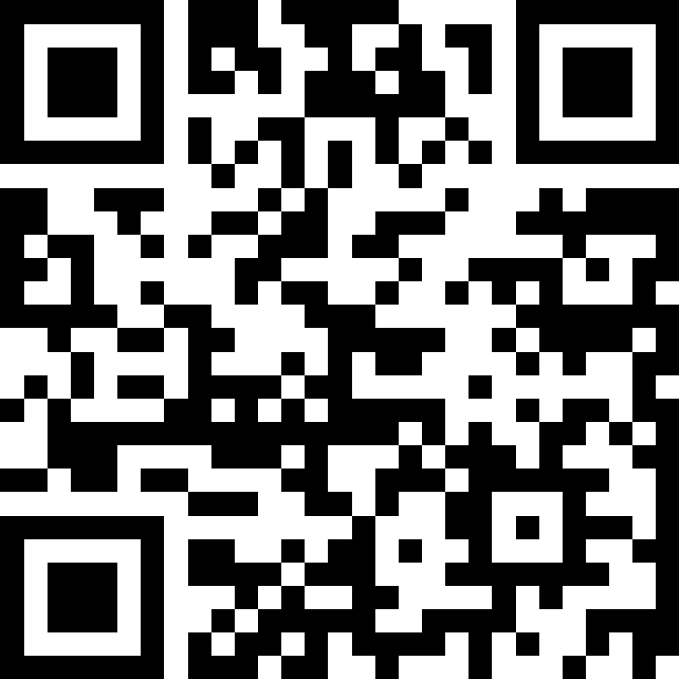
WORKING TITLE IDEAS…
AGENCIES WITH
NO PROCUREMENT
STAFF
MCC
MLOT
MPERA
MSL
OPD
PSC
TRS
Join at:
Slido.com
#25640374
19

Slide 20
CENTRAL HR ROLES AND RESPSONSIBILITES
Enterprise HR Programs, Policies, and Business Services:
Compensation and Classification
ADA/EEO
Enterprise Learning and Development
Employee Assistance Program
Advising Agency HR Leaders on state policy, rules, statutes, and practices.
HR Information Systems: Manage and maintain the following enterprise systems.
Core HRIS System (SABHRS)
Performance Management and Training (TALENT/LEARN)
Recruitment System (SOMRS)
Central Payroll Processing:
  State/federal payroll tax management.
  Deductions management.
  Manage biweekly processing of enterprise payroll.
Labor Relations:
  Negotiate the biennial pay package for state employees.
  Negotiate collective bargaining agreements for each of the state's bargaining units.
  Assist agencies administering collective bargaining agreements.
  Represent state government in administrative hearings and labor arbitrations.
20

Slide 21
AGENCY HR TEAMS - ROLES AND RESPSONSIBILITES
The support provided by agency assigned HR staff is not changing. Agency HR teams will continue to offer the same core support and services to their assigned agency while proactively engaging with the HR Business Services Bureau. There will be an expectation that items will be elevated to the HR Business Services Bureau for awareness.
Recruiting / New Hire Onboarding
Employee Offboarding / Exit Interviews
Agency Level Workforce Planning / Strategies
Agency Level Pay / Compensation Strategies and Requests
Position Classification
Leave Management
Advising on HR Policy & Labor Law
Labor Relations / CBA Adherence & Support/LMCs
Ensures Alignment with Enterprise HR Policy / Strategies
Agency Specific Training & Development
Employee Safety / Workers’ Compensation
Bi-Weekly Timesheets / Payroll Verification
21
Notes:
There is no change from the agency HR current duties. HR staff embedded in

Slide 22

ELEVATION TO HR BUSINESS SERVICES BUREAU
Below are examples of items that are expected to be elevated to the HR Business Services Bureau for awareness. Agency HR teams will continue to support their assigned agencies through these situations and will notify the bureau for awareness and guidance. The HR Business Services Bureau will engage as needed; not all situations will require their direct involvement.
Interventions are being considered that may impact statewide HR policies, pay plans, job classifications, or labor relations.
A request involves an exception to policy or deviation from standard classification or compensation rules.
An agency head or senior official requests HR action that may conflict with statewide direction or employment law.
Formal disciplinary actions at the due process step for awareness.
Labor relation items such as grievances, corrective actions, proposed settlements, compensation requests, requests for MOUs, and mandatory subjects of bargaining.
Employee complaints regarding harassment, sexual harassment, and discrimination.
Classification requests for HR positions or for leadership positions with oversight of HR.
Pay adjustments and lump-sum requests.
Personal appointed position requests.
Department-specific policy development requests.
All reorganizations.
All Reductions in Force (RIF).
All proposed demotions: discipline, reorganization, etc.
22
Notes:
Shifting to proactive vs reactive

Slide 23
AGENCY HR ORGANIZATIONAL STRUCTURE IMPACT
Payroll, Safety, Training, and Wellness positions will remain agency specific and not transfer to DOA. These positions can still report within the agency HR organizational structure.
The Agency HR Leader will report directly into SHRD HR Business Services Bureau and will maintain a dotted line to an agency specific leader. Agency Leaders will become DOA SHRD employees.
The Agency HR Leader will supervise the HR employees assigned to provide services to the respective agency. Agency HR staff will become DOA SHRD employees.
Supervision, performance management, and policy guidance for the Agency HR Leader are provided by SHRD in collaboration with the agency leader.
23

Slide 24
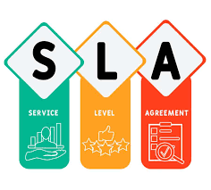

SERVICE LEVEL AGREEMENT
SERVICE LEVEL AGREEMENT
There will be an SLA for HR services for each agency.
  Defines the scope of HR services provided by SHRD to the agency.
  Describes the operating relationship between SHRD and the agency.
  Outlines the roles, responsibilities, and expectations of the parties.
Individual agency meetings will be scheduled to work through and finalize the SLA.
RESPONSIBILITIES AND EXPECTATIONS MEMO
Outlines responsibilities for both Agency HR Leaders and Central HR.
24

Slide 25
LOOKING AHEAD

Slide 26


HR KNOWLEDGE AND EXPERIENCE SURVEY
SURVEY PURPOSE
This survey allows us to better understand the knowledge and experience of current HR staff. This survey will provide an opportunity for us to hear from HR staff about their experience, strengths, and interest in development. It will provide staff an opportunity to share ideas and feedback around centralization. Following this survey SHRD will be able to prioritize training needs, identify SMEs, and develop a mentorship program.
AUDIENCE
Agency HR staff identified through the recent discovery process who would most likely be part of the centralization into SHRD.
CONTENT
Self-evaluation of each HR practices area, opportunity to share areas of interest for development, and interest in mentoring.
PROPOSED TIMELINE
  Dec 4 – Announce survey and share details with enterprise HR staff at the HR Symposium.
  Dec 8 – Email inviting HR staff to participate in the survey.
  Dec 19 – Deadline for survey completion.
26

Slide 27
CURRENT HR CENTRALIZATION PRIORITIES
IMMEDIATE PRIORITES:
Confirm position mapping with agencies
Finalize agency service level agreements (SLAs)
Finalize SHRD organizational structure and working titles
Recruit HR Business Services Bureau Chief
Define SABHRS roles and security structure
Develop talent performance management templates
Determine funding model with OBPP
Finalize transfer details for all centralization initiative
TRANSITION PRIORITES:
Develop agency centralization onboarding plan
Inventory and review agency‑specific policies, procedures, and forms
Establish enterprise priorities for standardization
Establish a process for agency HR engagement on standardization initiatives
  Create an ongoing feedback channel for agency HR and agency leadership with SHRD
27

Slide 28
CENTRALIZATION INITIATIVES

Slide 29

STAFF TRANSITIONS – LOGISTICAL ITEMS / TOPICS
STAFF TRANSITION PLANNING
As staff transition from agencies to DOA, a multitude of logistical issues need to be addressed to support a smooth transition. Planning is underway to address these topics.
Examples of these topics include:
C Number
Maintaining current email addresses / emails
Accommodating ‘dual’ reporting structures within all HRIS systems
Ensuring staff have appropriate system access for their role
Transition of IT hardware/software assigned to individual employees
Personnel files and related information (e.g., I-9s, FMLA, etc.)
Badges and Access
Current DOA Background Check Requirements
Transition of Leave Balances
VEBA Groups / Memberships
ProCard Transition / Protocols
Travel Expenses
Signature Blocks
Business Cards
Work Cellphones / MDM Reimbursement
Outlook
  Address Book Agency
  Distribution Lists
Staff Requests with Dual Reports To
  Schedule, leave, remote work approval
Recruitments for Centralized Positions
Pay Adjustment Requests for Centralized Positions
Agency budget management – training and development example
29

Slide 30

CENTRALIZATION RESOURCES
  Procurement Centralization
      DOA Human Resources
        Natasha Cook, DOA HR Generalist
  IT Centralization
      DOA Human Resources
        Chris Bacon, DOA HR Manager
      Weekly Update Emails
  Union Questions
    DOA SHRD Office of Labor Relations
      Karol Anne Davis
      Christian Mackay
      Caitlin Buzzas
Centralization Resource Center
    centralization.mt.gov
    Updated FAQs, Presentations, General Updates
HR Centralization
    DOA State Human Resources Division (SHRD)
      Karol Anne Davis and Dean Mack
30

Slide 31
Q&A

