Slide 1
Virtual and Remote Work Best Practices
MANAGER GUIDANCE

Slide 2

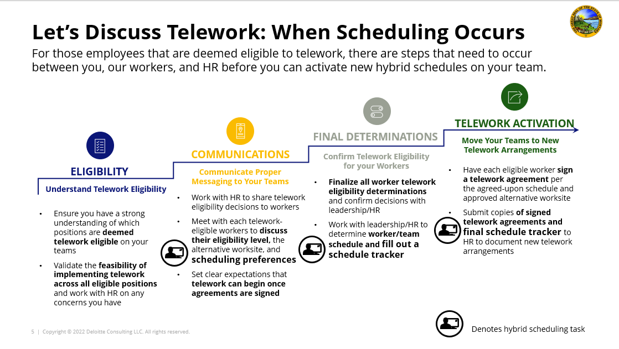
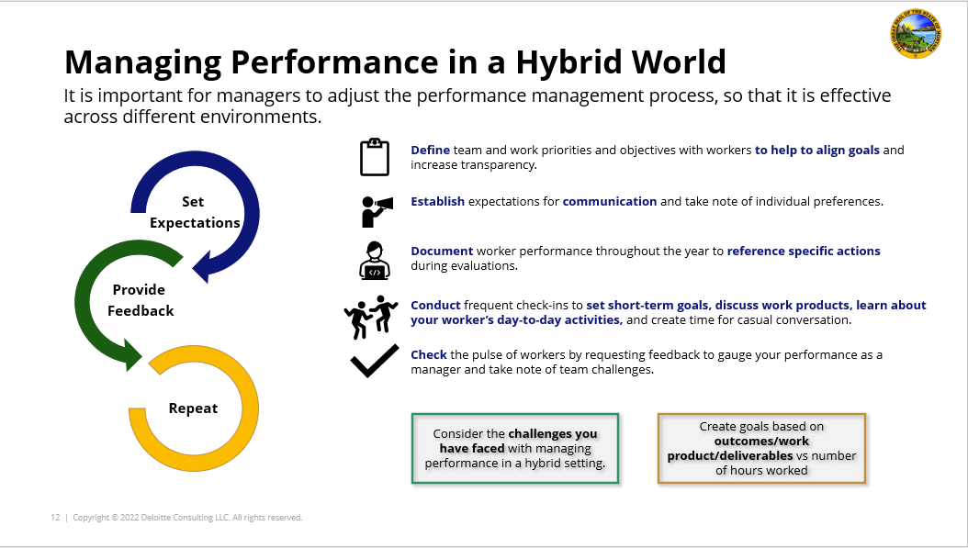
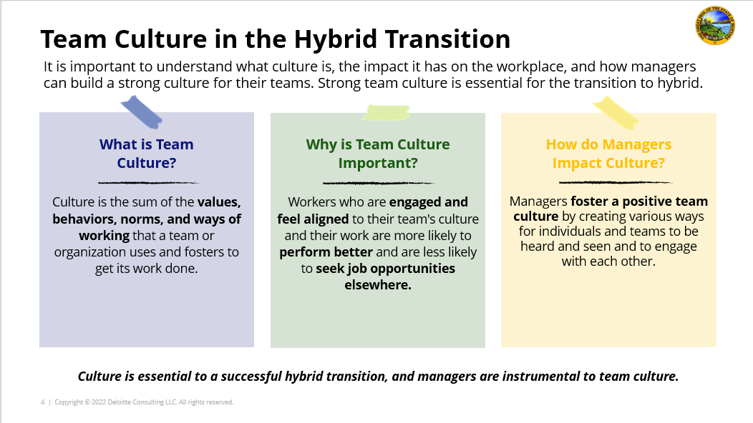
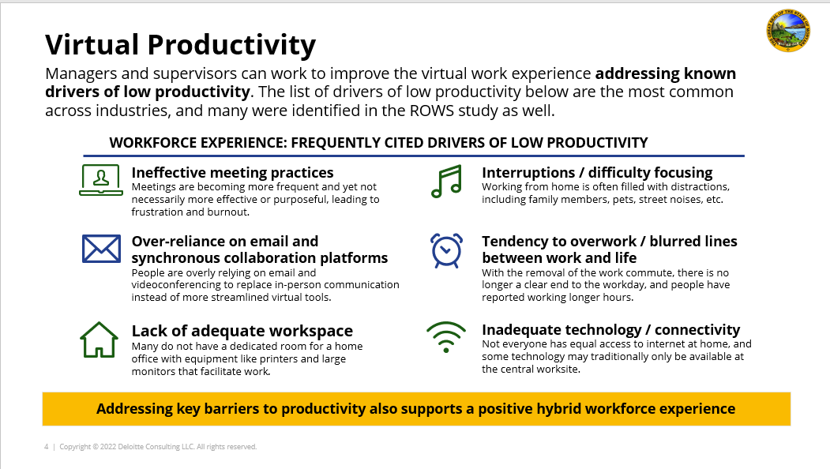
Table of Contents
Telework Guidance Overview
Goals and Objectives.....……………………..... 3
Overview of Common Terms………………………………. 4
Working Virtually………….. …..……..........…...………… 5-8
Virtual Productivity…………………………….. 6
Virtual Collaboration and Inclusion………….. 7
Meeting Virtually: Etiquette and Professionalism… 8
Set Up For Success: Equipment…………….. 9-11
Home Office Set-up Best Practices…………… 10
Equipment Check……………………….. 11
Set Up For Success: Technology…………… 12-14
Digital Etiquette: Set Your Team Up to Win …………… 13
Digital Etiquette: Set Yourself Up to Win…………... 14
Additional Resources for Telework…………. 15
Scheduling Telework for Success
Learn how to optimize how time is spent virtually and in-person while considering the unique needs of your team.
Managing Virtual Teams
Learn how to adapt your management style to the new virtual environment.
Fostering a Strong Telework Culture
Learn how to build a strong, positive team culture by prioritizing inclusion, empathy, and well-being.
Virtual and Remote Work Best Practices
Learn how to excel at virtual collaboration and equip your team for success in virtual work.

Slide 3


Goals and Objectives
As the State of Montana implements new ways of working, managers must lead by example in a virtual environment. To serve Montana’s citizens and the needs of its workers, virtual collaboration is more important than ever. Guidance is needed to optimize how time is spent virtually and in-person, and to identify which enabling tools are most effective, while considering the unique needs of each team.
Managers should use this guidance to…
Did you know…
[vir·​tu·​al]
The etymology of the word, “virtual” is derived from the Latin word, virtus, meaning strength and virtue. When paired with inclusion, this is a powerful concept
Be intentional about implementing virtual inclusivity on your project teams
Embrace virtual inclusion and be empowered with tangible resources
Support unique team needs in a telework environment
Incorporate tips and best practices to facilitate productive and inclusive environments
*If you work in a non-telework eligible position or in the field full-time, this toolkit may not apply to your role. If you are uncertain if this guidance applies to you, please check with your HR manager.

Slide 4
Overview of Common Terms
Here’s a quick overview of some of the terms you will see in the ROWS guidance materials.
Telework vs. Remote
Definitions and Terminology
Telework | Refers to the state of working from your designated alternative worksite, as opposed to ‘in-person’ at your central worksite.
Central Worksite | Refers to your primary designated office building, where you would be expected to report on non-telework days.
Alternative Worksite | Refers to your primary designated telework worksite, where you would be expected to report on telework days.
Telework / Virtual Environment | Refers to any working environment that involves some or all participants to be at an alternative worksite or joining virtually / telephonically.
Performance Management | Refers to the process of evaluating performance and providing feedback on an ongoing basis throughout the year.
‘Heads Down’ Time | Refers to time spent working individually at your own desk, whether at the central or alternative worksite, on a specific task or project.
Teleworkers:
Workers who are deemed to be ‘telework eligible’ will be expected to work in-person in the central worksite at a “low,” “medium,” or “high” level, according to their function, assigned schedule, and individual telework agreements.
Remote workers:
Workers who are deemed to be ‘remote eligible’ are not expected to work in-person at the central worksite and will be at an alternative worksite 100% of the time. Remote workers will only be expected to return to the central worksite on a limited exception basis for specific needs, such as for mandatory all-employee meetings, in-person trainings, project kick-offs, and team building exercises.

Slide 5

Working Virtually

Slide 6
Virtual Productivity
Improve the virtual work experience by addressing known drivers of low productivity. The list below includes the most common across industries, with many identified in the ROWS study.
WORKFORCE EXPERIENCE: FREQUENTLY CITED DRIVERS OF LOW PRODUCTIVITY
Ineffective meeting practices
Meetings are becoming more frequent and yet not necessarily more effective or purposeful, leading to frustration and burnout.
Interruptions / difficulty focusing
Working from home is often filled with distractions, including family members, pets, street noises, etc.
Over-reliance on email and synchronous collaboration platforms
People are overly relying on email and videoconferencing to replace in-person communication instead of more streamlined virtual tools.
Tendency to overwork / blurred lines between work and life
With the removal of the work commute, there is no longer a clear end to the workday, and people have reported working longer hours.
Lack of adequate workspace
Many do not have a dedicated room for a home office with equipment like printers and large monitors that facilitate work.
Inadequate technology / connectivity
Not everyone has equal access to internet at home, and some technology may traditionally only be available at the central worksite.
Addressing key barriers to productivity also supports a positive teleworking experience

Slide 7
Virtual Collaboration and Inclusion
Working virtually shouldn't mean working 24/7. Here are some best practices for working virtually.
DO… | DON’T…
Create a work environment where video feed is allowed but not required | Suggest mandatory video-centric meetings
Stick to project norms around scheduling, capacity, and annual leave | Reject employee’s annual leave requests
Continue to use MS Teams chat, text, email, and calls to speak with your team | Over-schedule meetings to check in with your team
Be mindful of your team’s dynamic telework lifestyles | Imply more time should be spent at your computer
Speak with your team and consolidate disconnects around similar hours whenever possible | Schedule time that interferes with team’s lunch breaks
Listen to your team’s concerns and suggestions | Project your situation and outlook on your team
Teams have diverse sets of needs, so there is not a one-size-fits-all solution

Slide 8




Meeting Virtually: Etiquette and Professionalism
Virtual guidelines have been in place for some time, but there is always room to refresh best practices and tips. Below are some helpful ideas for conducting meetings for your teams.
All scheduled meetings should include a virtual meeting option for people to participate, see, and hear remotely.
Encourage but do not mandate use of the video camera to promote team connection.
Select a time when everyone can typically participate and establish the expectation that they will unless an extenuating circumstance arises.
Managers should hold team office hours to enable all employees to ask any questions they have.
Staff should be thoughtful about meeting participation and make it clear to people when they do not need to attend.
Consider shifting your meeting time to 25- and 50-minute slots, instead of defaulting to 30 and 60 minutes. This can help to optimize the time we spend in meetings.
Hold team meetings on a regular, predictable cadence because there are fewer opportunities for chance encounters.
Keep scheduled team meetings even if they end early – even a quick exchange may strengthen team connection.

Slide 9

SET UP FOR SUCCESS: EQUIPMENT

Slide 10



Home Office Set-up Best Practices
Staff should consider the following telework best practices when considering their home office set-up. Empower staff to make decisions for their environment.
Check that you have a reliable internet connection and be prepared for potential bandwidth issues (consider using your phone’s personal hot spot if needed).
Develop a daily routine: When are you working? When are you off? Make sure to schedule breaks!
Stay in close contact with your team and manager to ensure that your tasks are clear and your impact and performance are visible!
Make sure you have access to the appropriate tools and technology (e.g., MS Teams).
Clearly articulate with your team which mediums to use to communicate for what.
Be (easily) available during working hours and keep your (Outlook) calendar up-to date.
Check your equipment and make sure that you have what you need to work well (e.g., second monitor, ergonomic chair, etc.). Speak up about what your needs are!
Confirm access to security tools (e.g., VPN) and follow security guidelines.
Do not forget about socializing with your colleagues, consider virtual lunch or coffee dates if these are part of your routine.
Do not forget to disengage at the end of the workday and try to maintain an appropriate work-life balance.

Slide 11





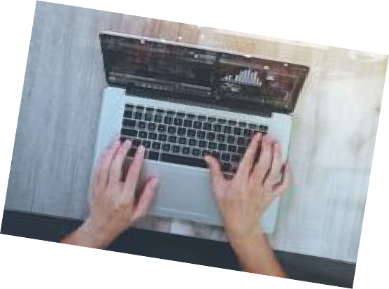


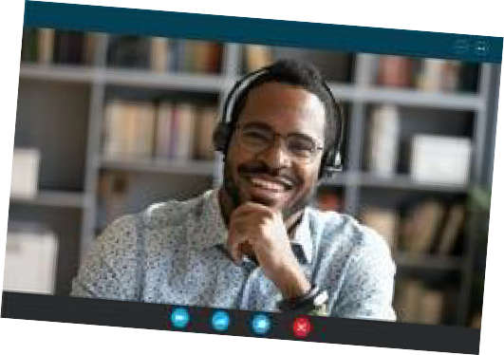




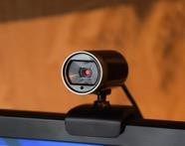
Equipment Check
Make sure that all of your peripheral devices are properly charged
Position webcam at or above eye-level for best angle
Test upload and download Speeds for your home network
Test meetings software and rehearse all technologies prior
Use a Laptop not a Mobile Phone for Video
Test
Your Technology
Use a Headset or External Microphone
Whenever possible, join the virtual call on a laptop or desktop computer to ensure a stable image.
Avoid moving around your house during video calls. If you must change locations, turn your video off first.
If you have a second monitor, turn it off during your virtual meeting to avoid issues with sharing screens.
Reduce the likelihood of technical surprises by testing your web conferencing application and internet / wireless connection.
Conduct an internet speed test on speedtest.net to ensure that your network can handle the requirements of your meeting (Zoom requires 1.2MB-1.8MB speeds for HD video).
Free up bandwidth by removing non-essential devices from your wireless network for the duration of your call.
For a backup plan in case your wireless network goes down, add your mobile device’s hotspot to your queue of networks so that you can quickly switch over if needed.
Having meeting participants use microphones and headsets produces the best sound quality.
Make sure you and all participants keep phones on mute when not actively speaking to avoid external noise.
If using a wireless headset, make sure it’s fully charged.
If you have issues with using your laptop for audio, dial in with your mobile phone and place your computer’s speakers and mic on mute.
If using your laptop’s speaker and microphone, be careful about ambient sounds such as typing on your keyboard.
Position the Camera
Password-Protect Your Meetings
Position your camera so that it’s
just above eye level. Prop it
up to reach that level if necessary.
Keep your meeting safe from
unwanted visitors.
Use a password to protect your meeting so that a hacker can’t gain access, post inappropriate content, or hijack your presentation.
Treat the camera’s lens as if it were your audience.
Create empty space between the top of your head and the top of the screen.
Consider an external USB camera for a better video
image and more flexibility for camera angles.

Slide 12
SET UP FOR SUCCESS: Technology

Slide 13






Digital Etiquette: Set Your Team Up to Win
In the new environment, assume many meetings will have mixed participants with some teleworking and some in-person.
Turn Off Notifications
Limit Open Programs
Turn On Video
Mute All Participants
Use Additional Features
Prevent distracting pop-ups by shutting down extraneous applications and notifications or setting them to “Do not disturb.”
Make sure you mute your cell phone to prevent any calls or messages from interrupting your meeting.
Ensure that you mute Teams chat feature.
Turn off email pop-up notifications while presenting in the meeting.
Minimize unrelated open windows and applications on your desktop to ensure that confidential information and/or contact details are not visible to participants.
Make sure your desktop is uncluttered and there are no confidential files visible.
Limit open windows to make it easier for you to toggle between content that you’re planning to share and lower the likelihood of distractions during your meeting.
Have everyone’s video automatically turned-on during login. It improves concentration and participation.
Find the setting in your meeting application where you can set video on for all participants.
Communicate that it will be a video call beforehand.
Place everyone automatically on mute as they join the meeting. This will avoid any uncomfortable feedback noises or loud background noises.
Where it makes sense, use the features your virtual meeting technology has to maximize collaboration and interaction during the meeting.
Consider using features like polling, breakout rooms, reactions and annotations that Teams offers.
Tip: Set your calendar default to end meetings 5-10 minutes early to allow participants a chance to take a break before their next meeting!

Slide 14



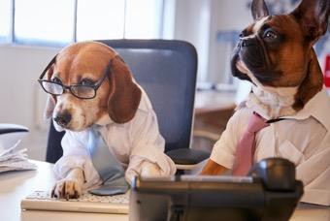


Digital Etiquette: Set Yourself Up to Win
Be Aware of
Your Surroundings
Create Good Lighting
Position the Background
Be Aware of MS Teams Status
Dress The Part
Be Aware of Your Body Language
Don’t forget – you’re on camera!
Be aware of your body language: sit up straight, avoid leaning in and making gestures.
Create uniform lighting on your face.
Avoid shadows and supplement your lighting with ambient light sources that result in a better image.
Ensure that your head and shoulders are visible.
Keep your hands away from your face.
Don’t fidget or lean forward or backward too much.
Maintain eye contact when speaking.
Present an open, engaged demeanor.
Make sure there are no doorways or windows in the frame to avoid unscheduled guest cameos.
Not everyone has a home office, but it’s important to create a professional workspace and appearance.
Dress as you would if you were meeting your attendees in person.
Pay attention to how your clothing appears with your background.
If your computer’s camera supports it, consider using a virtual background or a blur effect.
Use a neutral background, such as shades of gray or white.
Avoid Multitasking
Your devices are full of distractions. Don’t give in. Be fully present in your event.
Avoid working on other assignments or responding to other inquiries on your laptop or cell phone.
Limit distractions by closing programs and muting your devices.

Slide 15


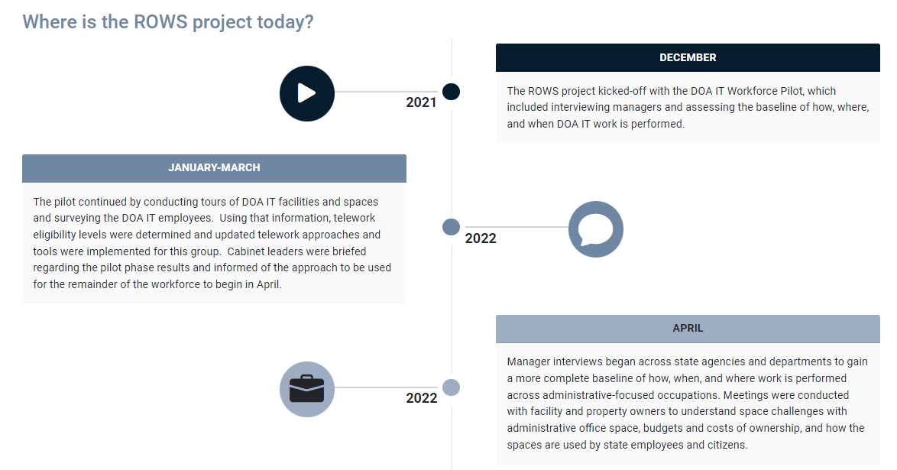
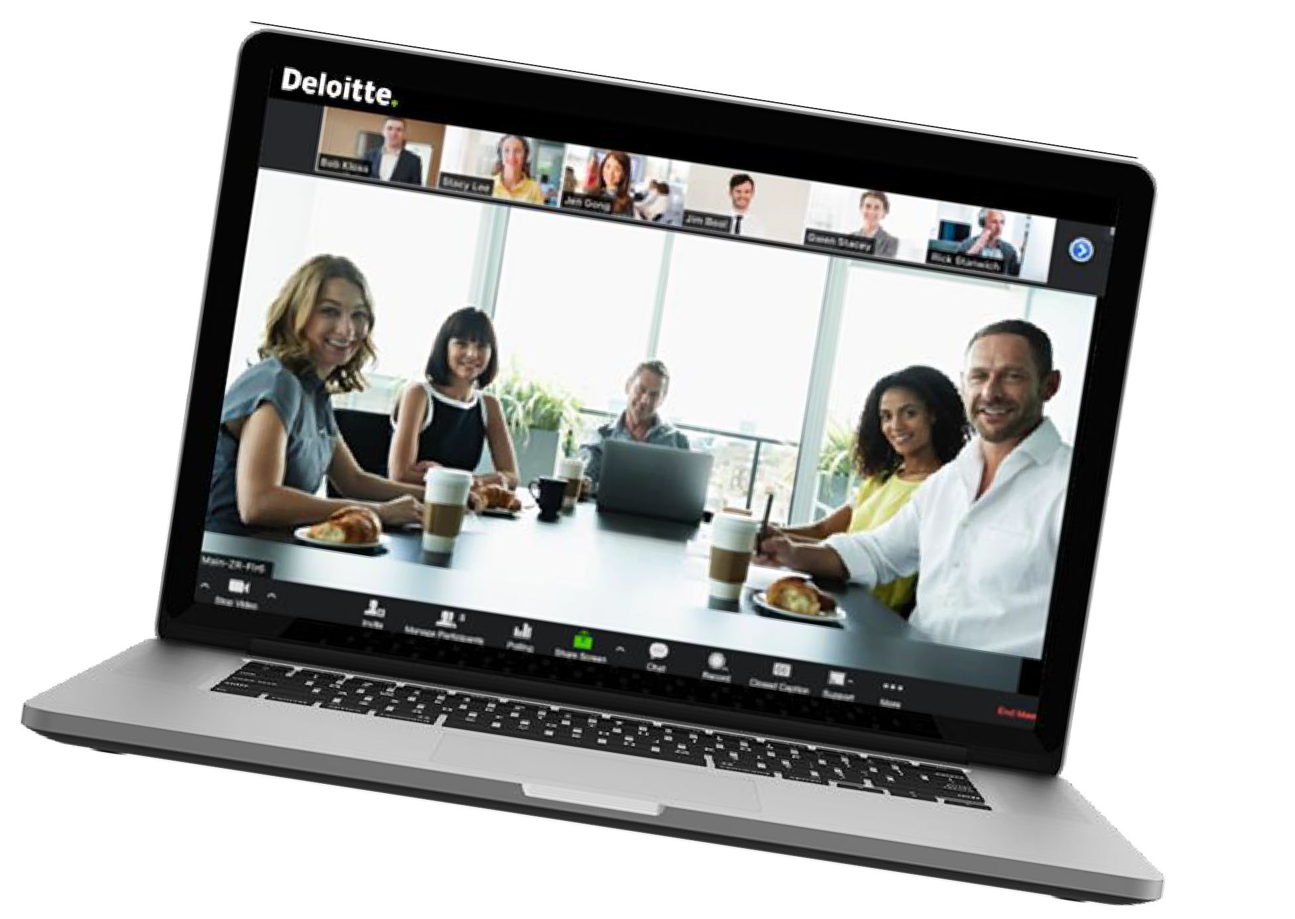
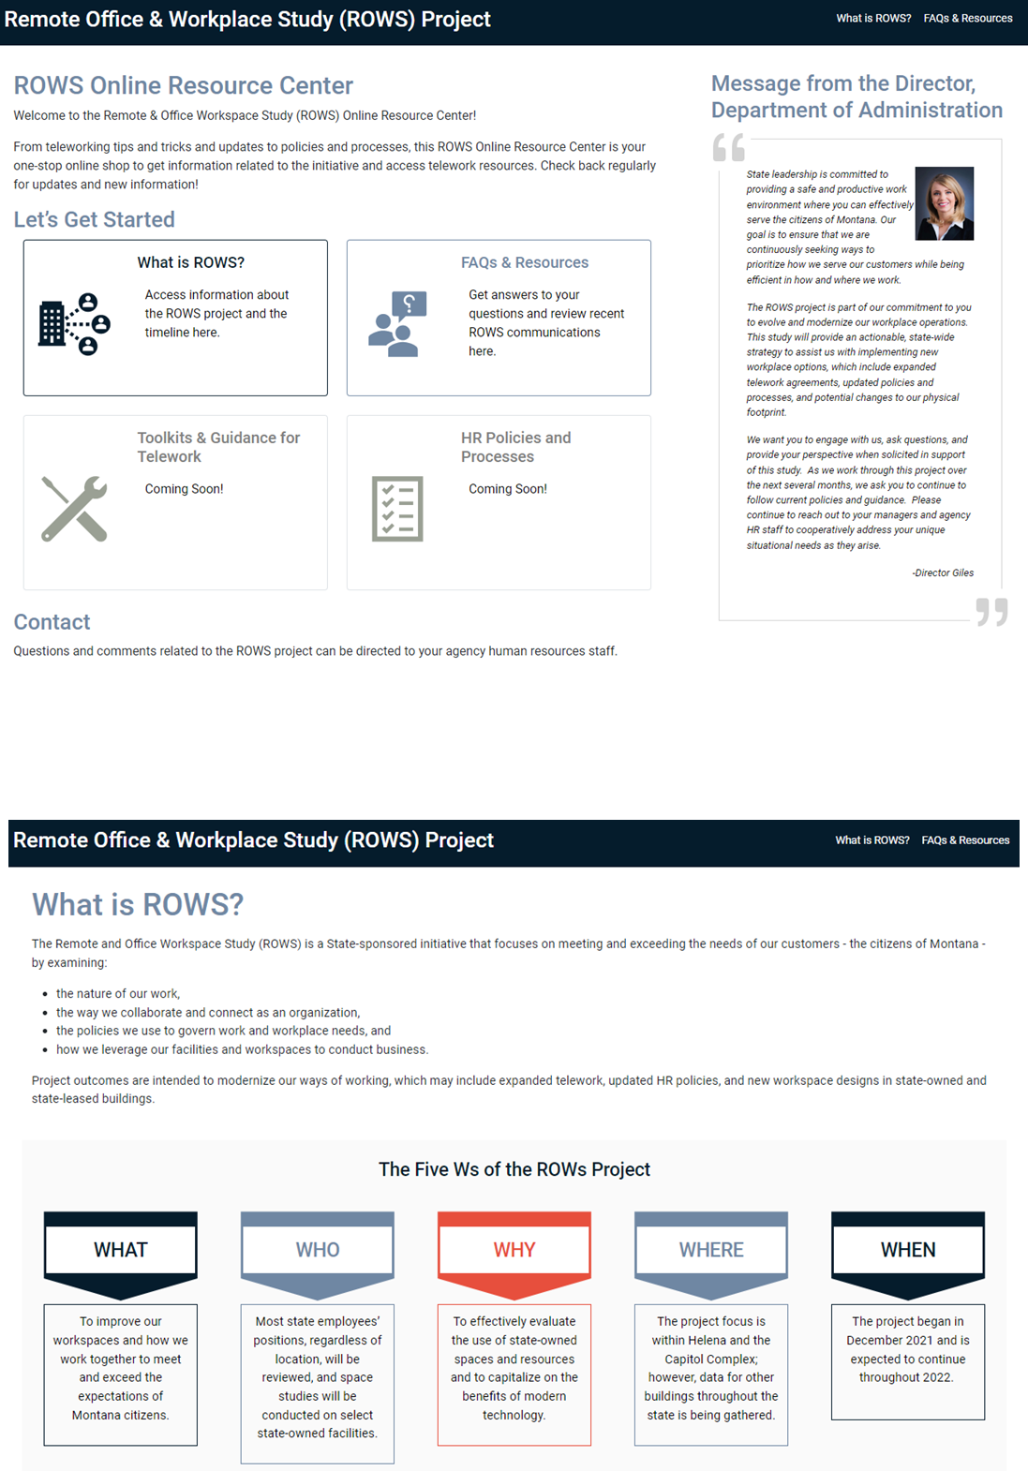
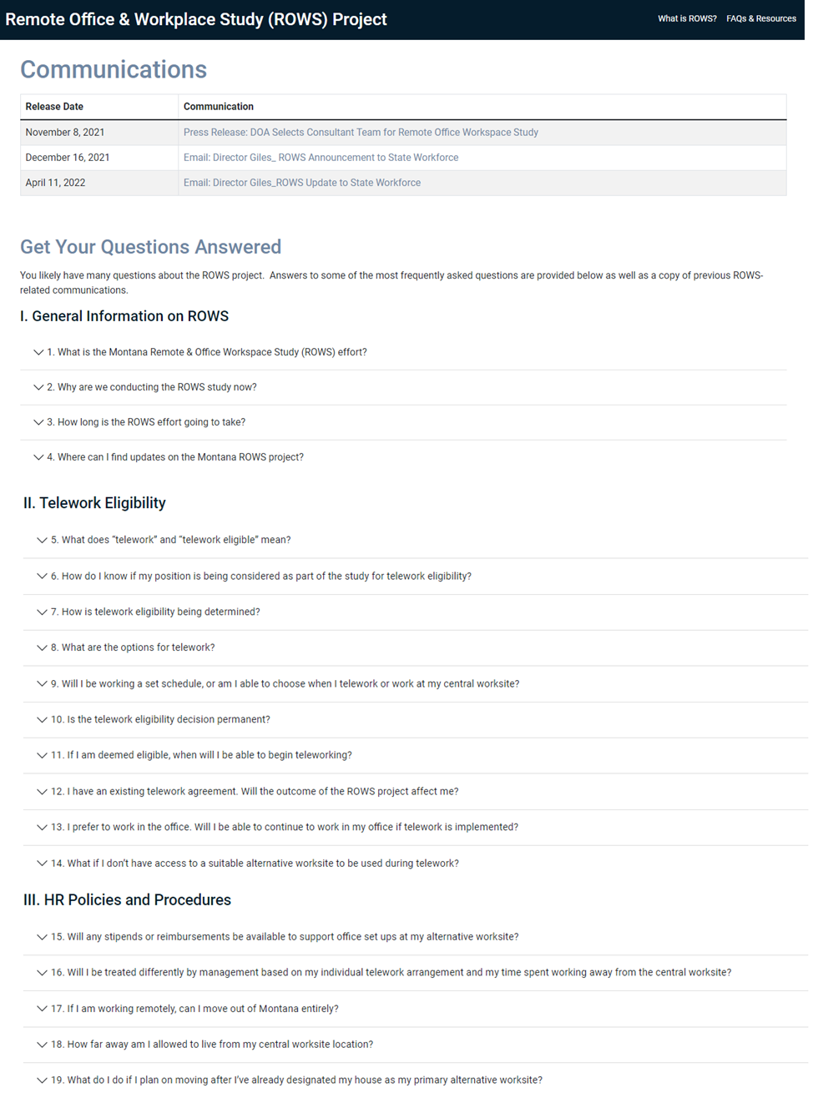
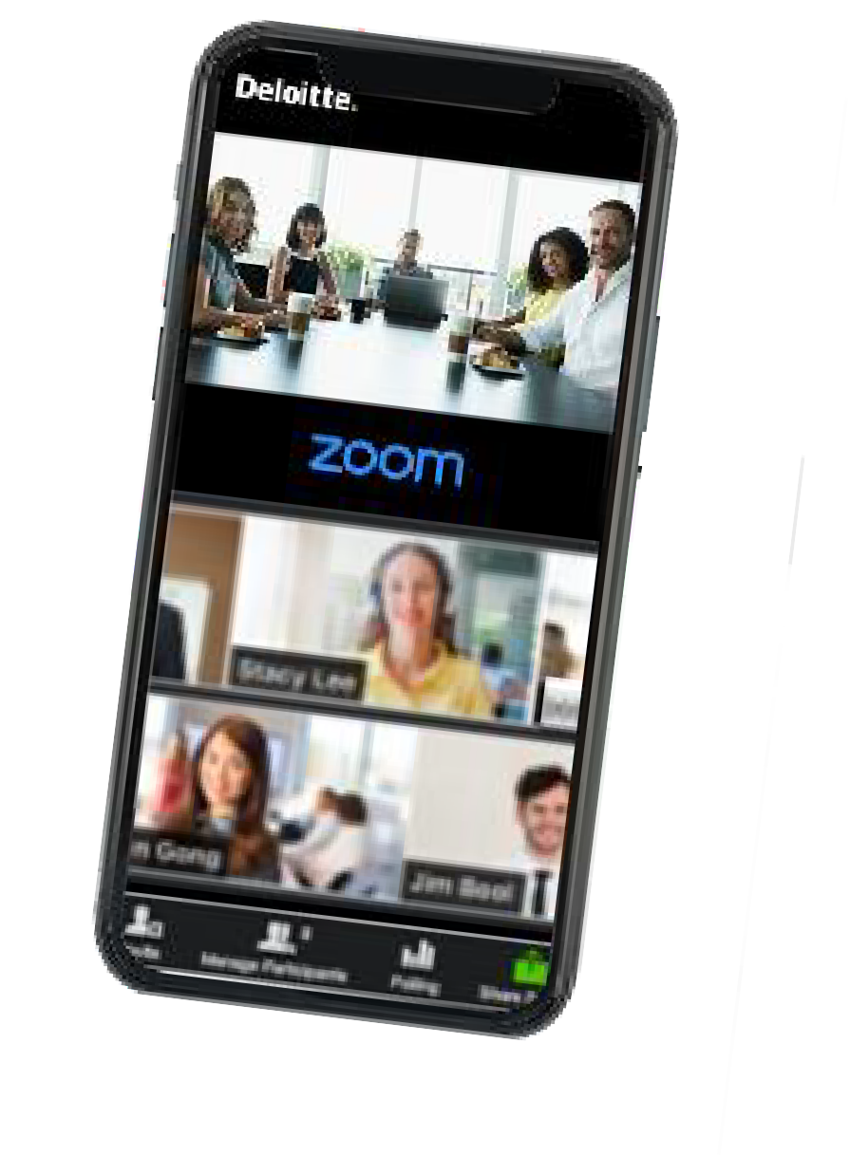


Additional resources for telework
Need additional help adapting to telework? Use the following resources to access technology software help, additional tailored ROWS guidance, and our Online Resource Center.
1
2
3
Technology Troubleshooting
ROWS Guidance
MT ROWS Online Resource Center
Scheduling Telework for Success
Managing Virtual Teams
Fostering a Strong Telework Culture
Virtual and Remote Work Best Practices
Access the Zoom Help Center, the Teams Help & Learning page, or the Microsoft Support site for self-service and live tech support.
Access the MT ROWS Online Resource Center (ORC) website for more about the Montana Remote and Office Workspace Study Project, telework policies, and other resources.

