Slide 1
Managing Virtual Teams
MANAGER GUIDANCE

Slide 2
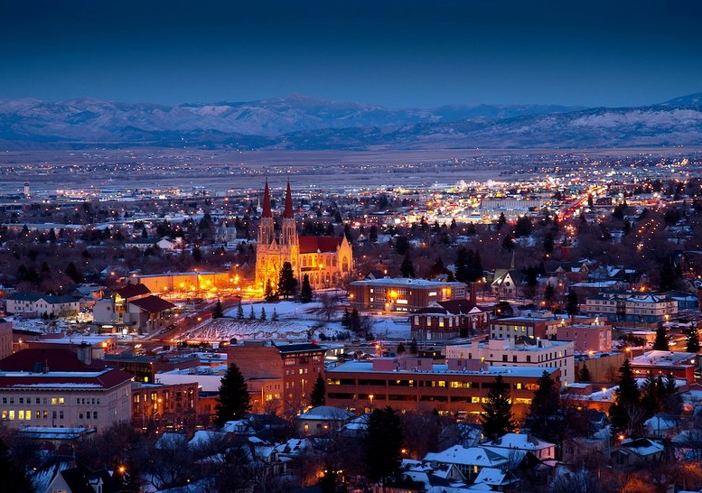
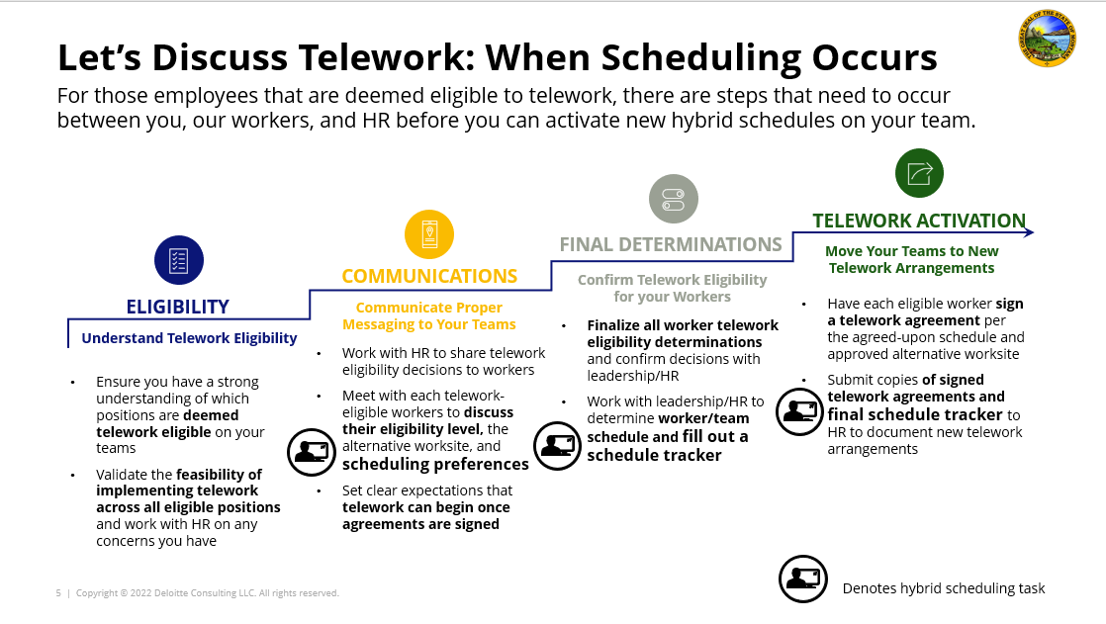
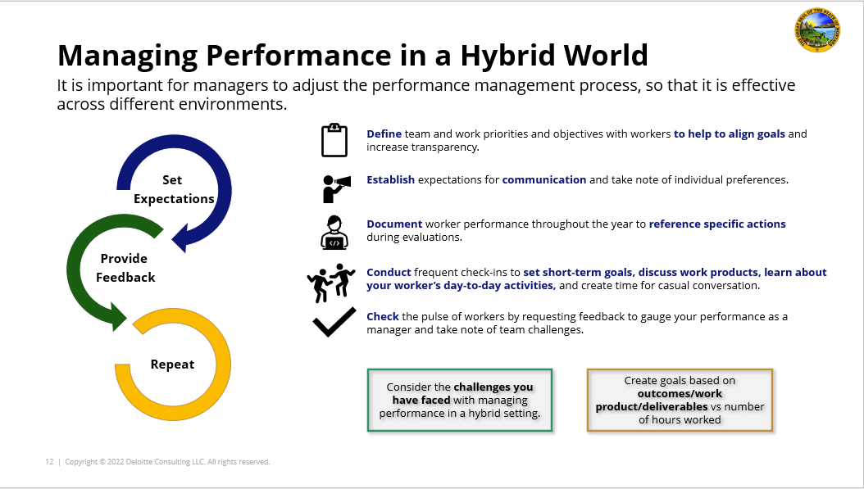
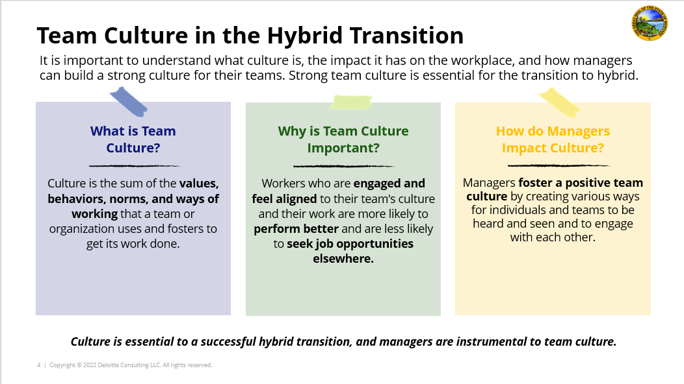
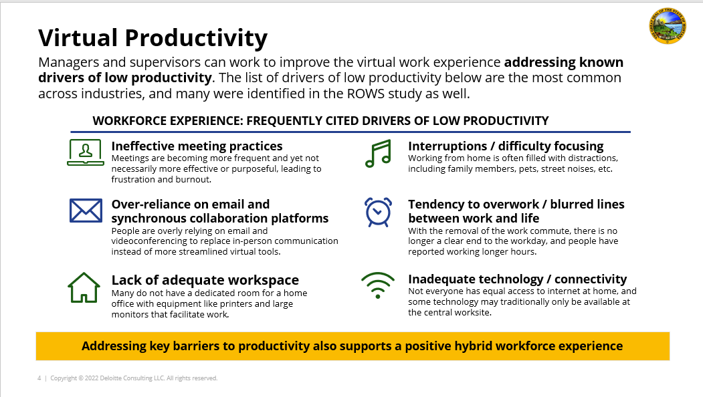
Table of Contents
Telework Guidance Overview
Goals and Objectives.....……………………..... 3
Overview of Common Terms………………………………. 4
The Transition to Telework………………... 5-9
What is your experience?……………………… 6
Manager Responsibilities: Ensuring Success……… 7
Manager Responsibilities: Leading Your Teams……. 8
Preparing for Scenarios: Resistance to Change…. 9
Equity and Performance Management………………... 10-15
Equity While Teleworking……………………………. 11
Managing Teams Equitably………………… 12
Managing Performance When Teleworking……… 13
Rethinking Performance Management (1/2)….............. 14
Rethinking Performance Management (2/2)…………… 15
Checklists: Preparing for Telework………………... 16-18
Manager Checklist……………………………. 17
Team Checklist……………………………………… 18
Additional Resources for Telework…………………………. 19
Scheduling Telework for Success
Learn how to optimize how time is spent virtually and in-person while considering the unique needs of your team.
Managing Virtual Teams
Learn how to adapt your management style to the new virtual environment.
Fostering a Strong Telework Culture
Learn how to build a strong, positive team culture by prioritizing inclusion, empathy, and well-being.
Virtual and Remote Work Best Practices
Learn how to excel at virtual collaboration and equip your team for success in virtual work.

Slide 3

Goals and Objectives
As the State of Montana implements new ways of working, managers play a critical role in leading teams during this transition. To serve Montana’s citizens and the needs of its workers, managers must understand their role and how they can adapt their management style.
Managers should use this guidance to…
Understand a manager’s role and responsibilities
Understand the benefits of virtual collaboration and teamwork
Understand how to be flexible and lead your team from anywhere
Learn how to apply new telework best practices for your team
*If you work in a non-telework eligible position or in the field full-time, this toolkit may not apply to your role. If you are uncertain if this guidance applies to you, please check with your HR manager.

Slide 4
Overview of Common Terms
Here’s a quick overview of some of the terms you will see in the ROWS guidance materials.
Telework vs. Remote
Definitions and Terminology
Telework | Refers to the state of working from your designated alternative worksite, as opposed to ‘in-person’ at your central worksite.
Central Worksite | Refers to your primary designated office building, where you would be expected to report on non-telework days.
Alternative Worksite | Refers to your primary designated telework worksite, where you would be expected to report on telework days.
Telework / Virtual Environment | Refers to any working environment that involves some or all participants to be at an alternative worksite or joining virtually / telephonically.
Performance Management | Refers to the process of evaluating performance and providing feedback on an ongoing basis throughout the year.
‘Heads Down’ Time | Refers to time spent working individually at your own desk, whether at the central or alternative worksite, on a specific task or project.
Teleworkers:
Workers who are deemed to be ‘telework eligible’ will be expected to work in-person in the central worksite at a “low,” “medium,” or “high” level, according to their function, assigned schedule, and individual telework agreements.
Remote workers:
Workers who are deemed to be ‘remote eligible’ are not expected to work in-person at the central worksite and will be at an alternative worksite 100% of the time. Remote workers will only be expected to return to the central worksite on a limited exception basis for specific needs, such as for mandatory all-employee meetings, in-person trainings, project kick-offs, and team building exercises.

Slide 5

The TRANSITION TO TELEWORK

Slide 6


What is your experience?
Complete the activity below to inspire thoughts about effective management.
Effective Management Techniques
Think back to a time when you had a leader that effectively managed change in your organization.
What techniques were used that had the biggest impact on you?
After completing this guidance module, compare what you’ve learned to your initial thoughts written here!

Slide 7

Manager Responsibilities: Ensuring Success
Managers play an essential role in ensuring that telework is a successful and productive experience for workers and the citizens we serve.
1
2
3
Stay mission-focused
Remind workers why they come to work every day and that citizens will ultimately benefit from the telework model.
Communicate effectively and often
Maintain effective communication by keeping channels for communication open.
Be empathetic and patient
The transition to telework is a big shift for many workers – change will be a gradual process. Try to understand your workers’ points of view.
4
5
6
Hold workers accountable
Supervise work activities and products to ensure accountability and to maintain productivity.
Make workers owners of change
Give workers the opportunity to participate in decision-making to the extent possible and allow them to feel like they are part owners of the change process.
Discipline fairly
If a teleworker’s productivity decreases or other performance/conduct issues arise, the manager should manage the issue no differently than they would a worker working at the central worksite.

Slide 8


Manager Responsibilities: Leading Your Teams
Managers need to balance leading their teams both in-person and virtually, which can be daunting. These tips can help managers to lead their teams more effectively.
RECREATE NATURAL INTERACTIONS
ORGANIZE DIGITAL SYSTEMS
Keep digital systems, such as Microsoft Teams or SharePoint, organized with accessible folders to minimize time spent searching for information.
Invite teleworking team members to turn on webcams so that the whole team is visible and able to recreate the ebb and flow of face-to-face discussions.
ENCOURAGE PRIORITIZATION
SCHEDULE PURPOSEFULLY
Increase mindfulness around meeting schedules and make meetings 25 or 50 minutes to build in breaks.
Help workers to prioritize critical tasks for the week and strategically schedule their days to help your overall team productivity.
VARY TEAM INTERACTIONS
ESTABLISH WELLNESS BREAKS
Mix up your interactions with teleworking team members by communicating through a blend of channels that make sense for their lifestyle and home office set up (e.g., texts, emails, video meetings, etc.).
Find ways to incorporate wellness into everyday routine and encourage workers to do the same. Consider a team wellness hour to set the tone.

Slide 9
Preparing for Scenarios: Resistance to Change
The scenarios below are potential conversations managers may encounter that would demonstrate resistance to change. Read through them to consider how they could be handled.
Scenario 1 Balancing Competing Interests | A manager comes to you because they are struggling with their team. Half the workers seem to want to be in-office full-time, and the other half are not convinced that in-office time is valuable. The manager wants to balance both sides’ concerns while staying true to the teleworking model.
Scenario 2 Scheduling With Purpose | Most of the managers in your organization are on board with the idea of telework. You overhear two managers talking about how they’re excited to get their teams back into the office and plan to do so on Tuesdays/Wednesdays/Thursdays only, every week, because this is what the managers feel is best for their schedules personally.
Scenario 3 Benefits of Coming Together | You get an email from a manager saying their team is very resistant to coming into the office at all. The manager cites reasons not to, including workers feeling more productive at home and the ease of childcare while working remotely.
Scenario 4 Changes to Telework Schedules | You get an email from a worker asking if they can change which days they come to the office. You want to be able to provide flexibility and show you understand the worker’s needs. However, you must also ensure the steps you take follow telework policies and are fair to other workers if they were to come with the same request.
Situations like these are an opportunity for managers to offer advice to peers based on approved policies and to affirm key communication themes around telework that should be shared with workers.

Slide 10

EQUITY and PERFORMANCE MANAGEMENT

Slide 11
Equity While Teleworking
Equity means fairness. Everyone receives fair treatment. Applying equity to teleworking means ensuring fairness in work experience, regardless of work location.
PROXIMITY Equity: Equity related to work locations of workers – consider difference in circumstances (e.g., mobile office, home office) and technology access (e.g., video conferencing) to enable the same outcomes remotely as others have participating in-person).
Transparency is needed to make sure that workers feel that they are treated equitably, regardless of their circumstances:
Set real expectations
Create a consistent workforce experience
Maintain standards and norms
Be objective and unbiased
Experience Equity: Equity related to the experience of performing job tasks and responsibilities and ensuring that workers have fair access and career advancement opportunities regardless of work location.
identity Equity: Equity from the standpoint of race, gender, sexual orientation, religion, disability status, and other cultural/personal identities and removing bias from decisions on work location options.
With some workers at their alternative worksites while others are at the central worksite, varied levels of visibility occurs with supervisors and other leadership. It is important that workers know that their contributions are noticed and that their performance will be evaluated fairly and equitably.

Slide 12
Managing Teams Equitably
It is important for managers and supervisors to be aware of equity concerns and be intentional about addressing them.
THE CHALLENGE:
Telework environments may create inequities and power differentials between those who are in-person and those who are working virtually at any given time.
WHAT IT MIGHT LOOK LIKE:
Different levels of
Visibility (e.g., less networking, less interaction with manager)
Access to resources (e.g., technology, equipment, reliable internet)
Access to information through formal and informal channels
Ability to adapt to new ways of working in a dynamic virtual environment
WHOM IT MIGHT IMPACT:
Those who telework more frequently
Women, who statistically bear greater responsibilities in caregiving and have left the workforce at greater rates during the pandemic, as they are likely to take advantage of more workplace flexibility
New hires and members of underrepresented groups who may lack a robust existing network to support them at work

Slide 13





Managing Performance When Teleworking
It is important for managers to use the established performance management process, so that it is effective and unbiased across different environments.
Define team and work priorities and objectives with workers to help to align goals and increase transparency.
Set
Expectations
Establish expectations for communication and take note of individual preferences.
Document worker performance throughout the year to reference specific actions during evaluations.
Provide
Feedback
Conduct frequent check-ins to set short-term goals, discuss work products, learn about your worker’s day-to-day activities, and create time for casual conversation.
Check the pulse of workers by requesting feedback to gauge your performance as a manager and take note of team challenges.
Repeat
Consider the challenges you have faced with managing performance in a virtual setting
Create goals based on outcomes, work product, and deliverables vs. number of hours worked
Notes:
Performance Management

Slide 14
Rethinking Performance Management (1/2)
Performance cannot be viewed through the lens of time spent working, but instead should be measured in outcomes and achievements, regardless of where work is done.
Upend Outdated Ideas about Performance Management
Avoid exclusively measuring…
Strive to holistically measure…
Traditional performance management was based on the idea of being in-person and working together.
In the virtual age, however, managers need the ability to accurately and fairly evaluate worker contributions when some workers are in the office and others are working from alternative sites.
…activities and where they are performed.
Activities produce results. Though it is easier to see the activities that in-person workers are performing, virtual tasks are just as important. Don’t forget to recognize and thank your workers for their work, whether you can see the effort that went in or not.
…accomplishments and outcomes.
Aim to measure performance by what was achieved. Outcomes are the final results of a team’s work and activities. Individuals and teams should be measured by their ability to accomplish goals over time through hard work and innovation, such as enhancing process efficiency, improving client satisfaction, reducing costs, etc.

Slide 15
Rethinking Performance Management (2/2)
Managers must learn to balance the many factors, both objective and subjective, that impact the productivity, efficiency, and success of their teams.
FACTORS TO BALANCE
When evaluating the performance of your teams, it is important to look at their work from all angles, balancing the concrete data with fluid activities and measuring the entirety of a workers’ contributions to the team and the department.
Skills-Based.
The core skills and competencies necessary to successfully operate on a daily basis
Results-Based. The indicators to measure progress based on outputs, outcomes, and impact
Qualitative.
A variable, abstract, and typically more open-ended form of measurement
Quantitative.
A data-driven, numerical, or statistical form of measurement
Objective. Impartial and concrete measurement without bias or prejudice
Empathetic.
Fair judgement of performance based on human empathy for the struggles a worker may be facing
vs.
vs.
vs.

Slide 16

CHECKLISTS: PREPARING FOR TELEWORK

Slide 17
Manager Checklist
Ensure that you are prepared to lead your team. The checklist below includes questions to ask yourself to better prepare you to manage virtual teams.
Workforce Engagement and Productivity
Hiring, Development, and Performance
Technology and Collaboration Tools
Planning, Policy, and Communications
What activities and interactions should occur in the office, and which should be accomplished through telework?
How frequently (and through what channels) will I meet and engage remotely with my team and with individual workers?
What skills do employees need in order to be successful in a telework model?​
Is our team prepared to provide onboarding and training to new staff about how to perform job duties and navigate teamwork in a telework environment?​
Am I prepared to manage and measure productivity and performance in a telework environment?
Are there workers who will want to work in the office on a regular basis due to an alternative worksite set-up that is not conducive to telework or is an unsafe work environment?
Does our team have access to the necessary hardware, software (including document sharing), documents, and data required to perform our duties?
Will my staff need to reserve workspaces before they come into the office?
Is there enough workspace and meeting space on any given day?
Will I need to coordinate with supervisors across the building to manage space effectively on days when both of our teams are in-office?
How often do I want to meet in-person with my team and with individuals to facilitate activities such as group work, onboarding, training, brainstorming, team-building, etc.?

Slide 18
Team Checklist
It is important to ensure that your team is prepared for the shift by reviewing the team checklist. The team checklist includes questions to ask your team to help you understand your team’s needs.
Workforce Engagement and Productivity
Hiring, Development, and Performance
Technology and Collaboration Tools
Planning, Policy, and Communications
What is working well as a teleworker? What could be improved?
What is working well as an in-person worker? What could be improved?
How do you prefer to work?
How often and when do you work independently?
How often and when do you work collaboratively?
Is the collaborative work you do most effectively accomplished virtually, in-person, or through a combination of both?
What can our team do to promote positive team engagement and morale?
What are some ways we could support your success while working in a telework model?
What concerns need to be addressed with your transition to telework?
Does our team have a supportive telework culture and the right attitudes toward work-life balance and teamwork?
Are there any space, technology, access, or confidentiality concerns/constraints that would prevent you from successfully working from home?
Are you aware of the virtual hardware and software that is available to you? Do you feel confident in your ability to use these tools?
Are you familiar with and do you understand State policies surrounding the transition to telework?
What should be some team norms or ground rules surrounding telework and virtual meeting etiquette?
We recommend sharing these questions with your team members through a survey or discussing them during tag ups, 1:1s, check-ins, etc.

Slide 19


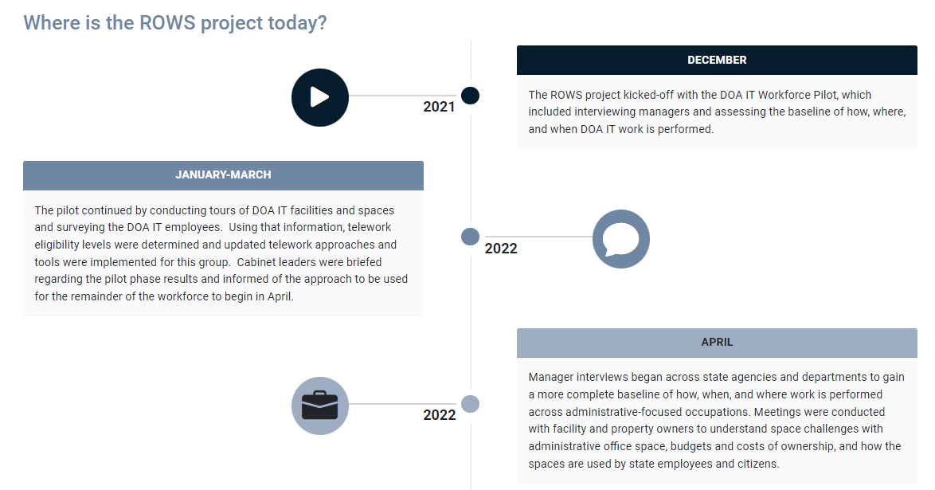
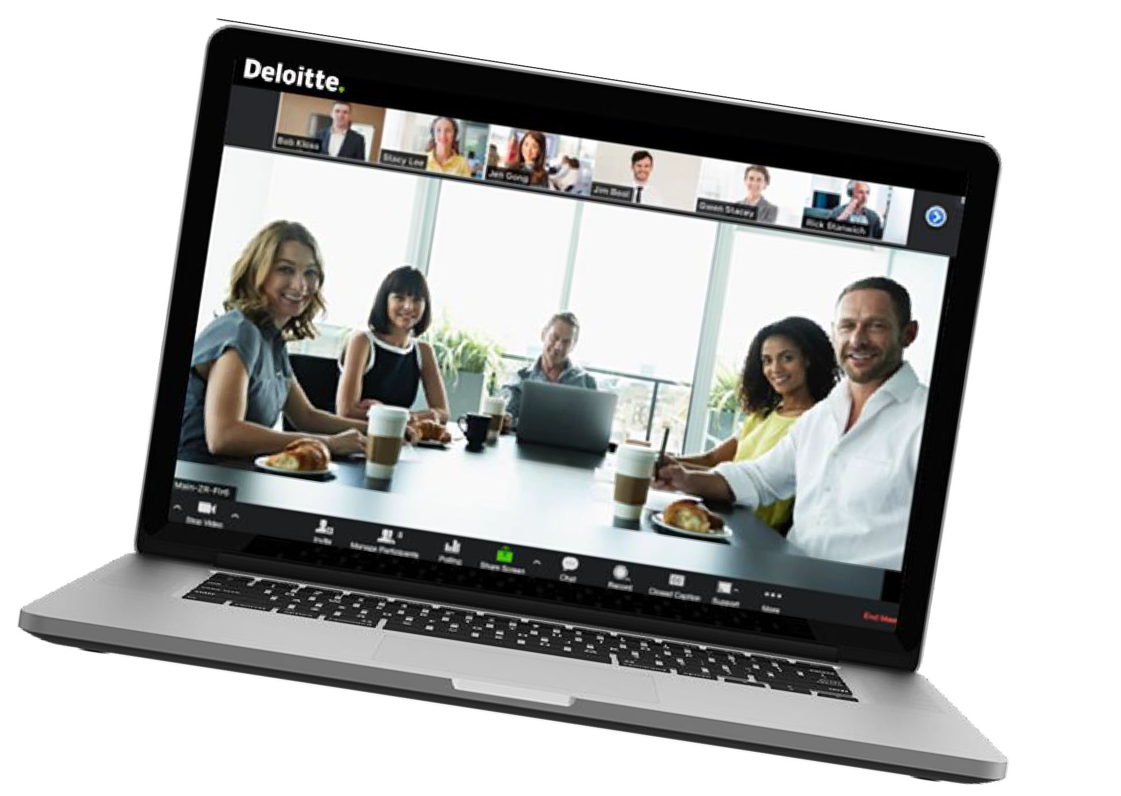
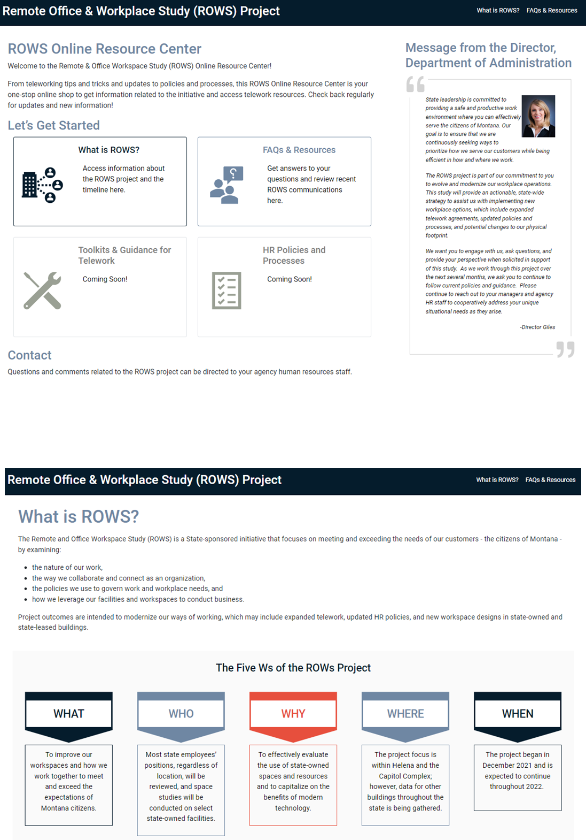
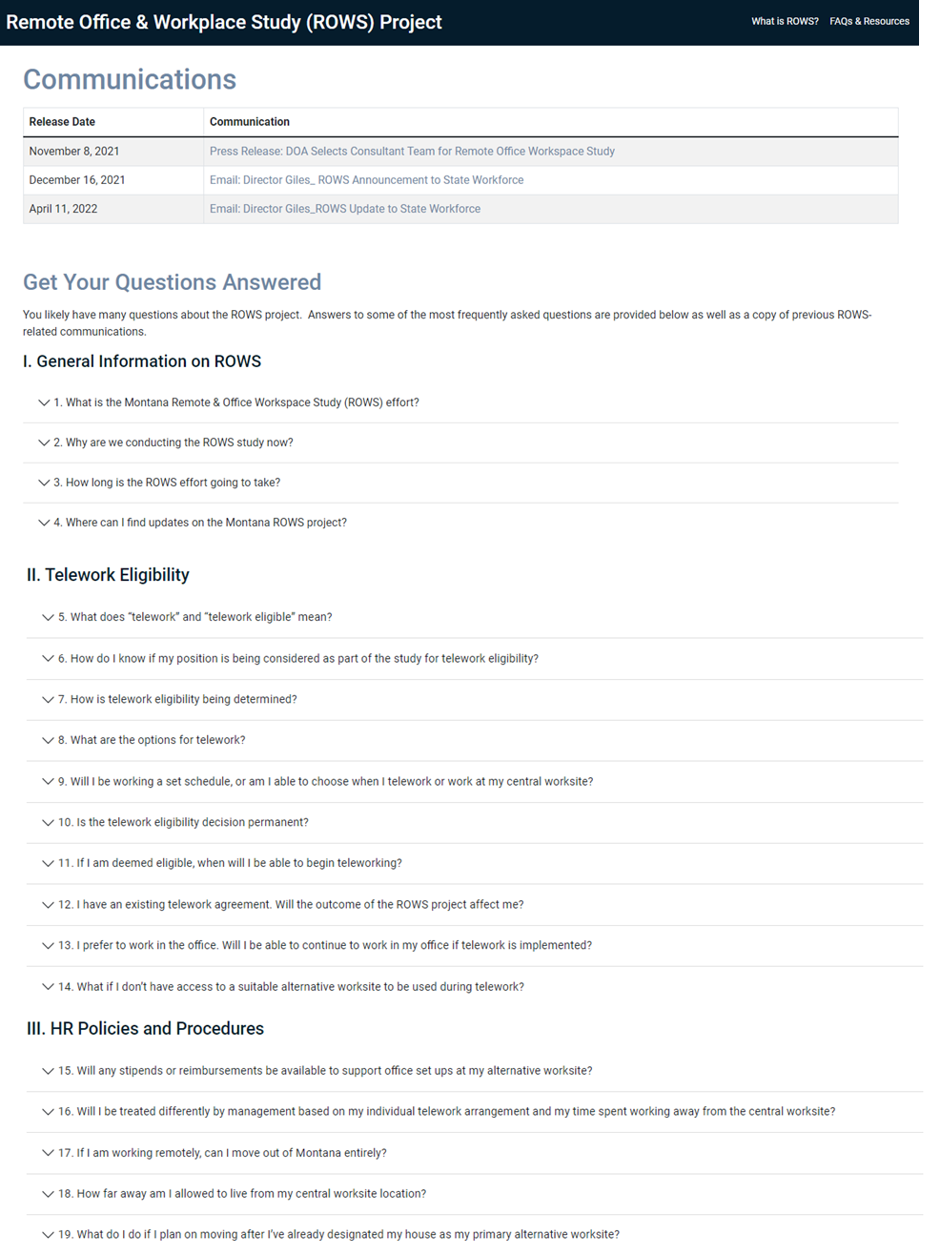



Additional resources for telework
Need additional help adapting to telework? Use the following resources to access technology software help, additional tailored ROWS guidance, and our Online Resource Center.
1
2
3
Technology Troubleshooting
ROWS Guidance
MT ROWS Online Resource Center
Scheduling Telework for Success
Managing Virtual Teams
Fostering a Strong Telework Culture
Virtual and Remote Work Best Practices
Access the Zoom Help Center, the Teams Help & Learning page, or the Microsoft Support site for self-service and live tech support.
Access the MT ROWS Online Resource Center (ORC) website for more about the Montana Remote and Office Workspace Study Project, telework policies, and other resources.

