Slide 1
Fostering a Strong Telework Culture
MANAGER GUIDANCE

Slide 2

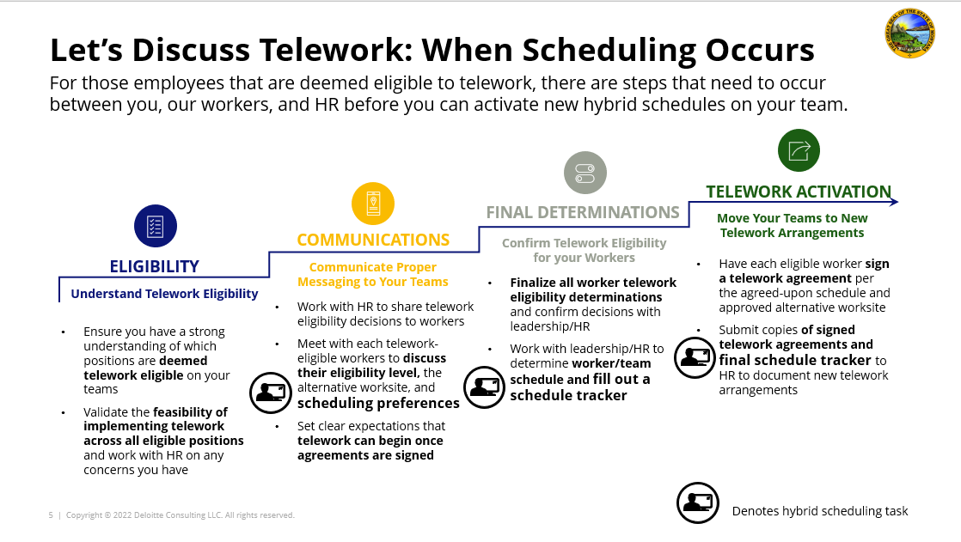
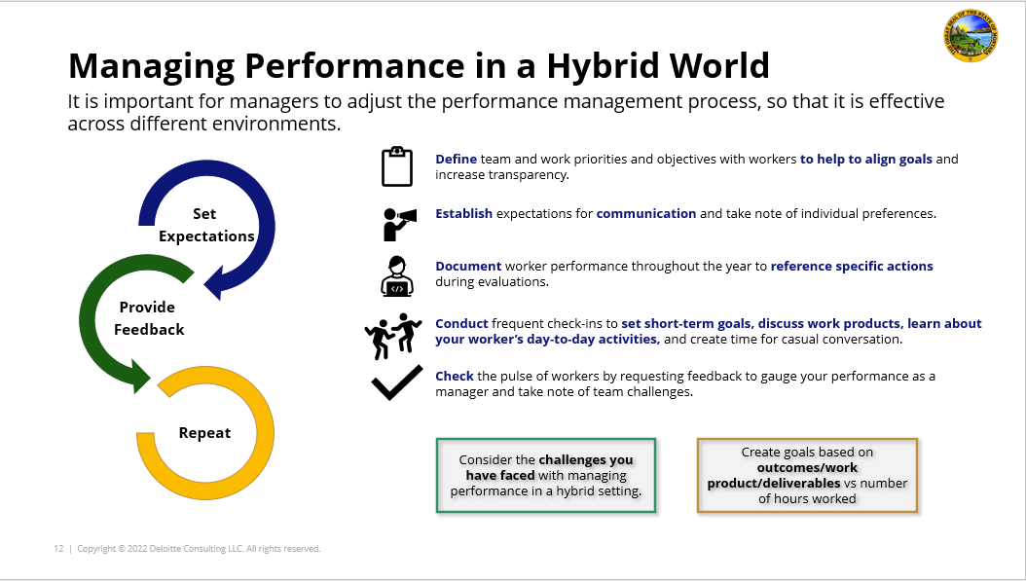
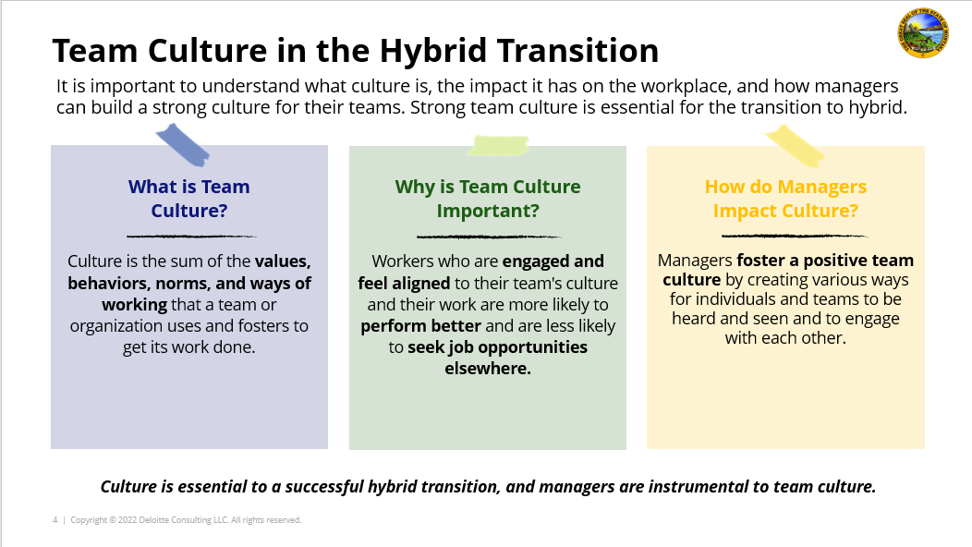
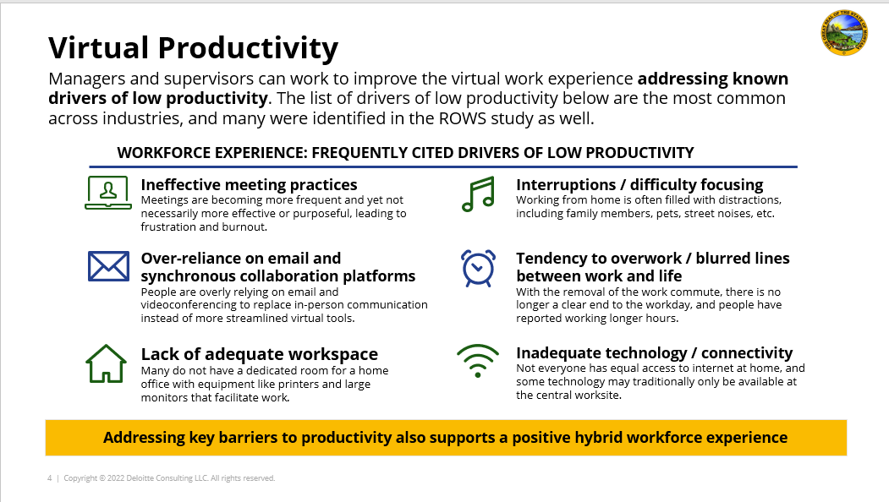
Table of Contents
Telework Guidance Overview
Goals and Objectives.....……………………..... 3
Overview of Common Terms………………………………. 4
Building Team Culture………....... 5-8
Team Culture in the Transition to Telework……… ……….. 6
Team Culture Challenges……………………….. 7
Setting the Stage: Team Culture Checklist……………………… 8
Creating an Inclusive Environment………………... 9-15
Creating Virtual Team Cohesion and Bonding……… 10
Promote an Inclusive Team Culture………………. 11
Virtual Hiring and Onboarding…………………………. 12
Communicating Formally and Informally………………… 13
Team Culture Roadmap: Brainstorm Break………… 14 & 15
Creating a Culture that Cares………………... 16-22
Empathetic Leadership…………………. 17
Ways of Working Activity……………………… 18 & 19
Well-being While Teleworking……….. 20
Promoting Team Culture by Prioritizing Wellness….. 21
Mental Health Resources……… 22
Additional Resources for Telework…………. 23
Scheduling Telework for Success
Learn how to optimize how time is spent virtually and in-person while considering the unique needs of your team.
Managing Virtual Teams
Learn how to adapt your management style to the new virtual environment.
Fostering a Strong Telework Culture
Learn how to build a strong, positive team culture by prioritizing inclusion, empathy, and well-being.
Virtual and Remote Work Best Practices
Learn how to excel at virtual collaboration and equip your team for success in virtual work.

Slide 3

Goals and Objectives
As the State of Montana implements new ways of working, managers will be expected to set the tone for positive culture-building, being inclusive, leading with fairness and empathy, and empowering workers to focus on their own mental health and well-being during and after work.
Managers should use this guidance to…
Understand a manager’s role and responsibilities
Understand the value of team culture, empathy, and well-being
Understand how to lead by example and foster positivity
Determine ways of empowering and engaging workers
*If you work in a non-telework eligible position or in the field full-time, this toolkit may not apply to your role. If you are uncertain if this guidance applies to you, please check with your HR manager.

Slide 4
Overview of Common Terms
Here’s a quick overview of some of the terms you will see in the ROWS guidance materials.
Telework vs. Remote
Definitions and Terminology
Telework | Refers to the state of working from your designated alternative worksite, as opposed to ‘in-person’ at your central worksite.
Central Worksite | Refers to your primary designated office building, where you would be expected to report on non-telework days.
Alternative Worksite | Refers to your primary designated telework worksite, where you would be expected to report on telework days.
Telework / Virtual Environment | Refers to any working environment that involves some or all participants to be at an alternative worksite or joining virtually / telephonically.
Performance Management | Refers to the process of evaluating performance and providing feedback on an ongoing basis throughout the year.
‘Heads Down’ Time | Refers to time spent working individually at your own desk, whether at the central or alternative worksite, on a specific task or project.
Teleworkers:
Workers who are deemed to be ‘telework eligible’ will be expected to work in-person in the central worksite at a “low,” “medium,” or “high” level, according to their function, assigned schedule, and individual telework agreements.
Remote workers:
Workers who are deemed to be ‘remote eligible’ are not expected to work in-person at the central worksite and will be at an alternative worksite 100% of the time. Remote workers will only be expected to return to the central worksite on a limited exception basis for specific needs, such as for mandatory all-employee meetings, in-person trainings, project kick-offs, and team building exercises.

Slide 5
Building TEAM Culture

Slide 6



Team Culture in the Transition to Telework
It is important to understand what culture is, the impact it has on the workplace, and how managers can build a strong culture for their teams. Strong team culture is essential for the transition to telework.
What is Team Culture?
Why is Team Culture Important?
How do Managers Impact Culture?
Culture is the sum of the values, behaviors, norms, and ways of working that a team or organization uses and fosters to get its work done.
Workers who are engaged and feel aligned to their team's culture and their work are more likely to perform better and are less likely to seek job opportunities elsewhere.
Managers foster a positive team culture by creating various ways for individuals and teams to be heard and seen and to engage with each other.
Culture is essential to a successful transition to telework, and managers are instrumental to team culture.

Slide 7
Team Culture Challenges
Virtual work presents new and unique challenges for workers. Managers should be aware of these challenges and work to address them by creating a strong team culture.
OUR NEW CHALLENGES
DISTANT WORK LOCATIONS
NEW EQUITY CONCERNS
BALANCING ROLES
HEIGHTENED STRESS
Working in separate locations minimizes face-to-face interactions and socializing between workers.
Depending on in-office scheduling, workers can have different levels of access to supervisors and leaders.
With blurred lines between work and home, workers must balance many roles (e.g., homeschooling, caring for family, or attending to pets).
Always having direct access to their work laptops and emails may lead to workers finding it hard to disconnect.
LONELINESS
from the lack of informal interactions with coworkers
QUESTIONS ABOUT FAIRNESS
due to varied levels of visibility with leadership
LIMITED AVAILABILITY
due to balancing at-home roles and their workload
BURNOUT
from the inability to disconnect

Slide 8
Setting the Stage: Team Culture Checklist
This checklist is not a scorecard. Read through each of these questions and determine whether they accurately describe your current team practices and dynamic.
Is my team…
Flexible?
Innovative?
Resilient?
Our team promotes collaborative work
Our team can handle unexpected changes
Our team culture is inclusive, fair, and respectful
Our team members are empowered to work together as needed to complete projects
Our team uses our physical and virtual spaces effectively to ensure that all team members can participate and contribute, regardless of their work location
Our team encourages new, creative, and different viewpoints
Our team culture promotes experimentation and new ideas
Our team empowers talent at every level to make work-related decisions as appropriate
Our team effectively uses the right data to make key business decisions
Our team is quick to address lessons learned from failures, mistakes, or pilots
Our team makes small changes frequently instead of big changes infrequently
Our team can manage unplanned change without it slowing us down or reducing our impact
Our team acts on real-time customer interaction data to improve citizen experience
Our team celebrates its collective achievements
Our team regularly collects and acts quickly on feedback from teams
Our team operates with purpose, integrity, courage, and shared focus
Flexibility, Innovation, and Resilience are all qualities of a positive team culture, but they are just a starting point. Take some time to determine what else you would include in your ideal team culture.

Slide 9
CREATING an inclusive environment

Slide 10
Creating Virtual Team Cohesion and Bonding
In a virtual environment, inclusion can happen as easily as in face-to-face environments, but it takes the right activities and purposeful actions.
}
The 5 Cs of the Workplace
The 5 Cs are not limited to in-office activities
CONNECTION
To achieve team inclusion, cohesion, and bonding, incorporate the 5 Cs into virtual activities.
EXAMPLES:
Encourage Virtual Coffee Chats: Offer to connect your workers spontaneously through one-on-one coffee chats to keep people engaged across your team.
Brainstorm Spontaneously: Choose one person each week to facilitate a spontaneous brainstorm session to problem solve and uncover new ideas.
Review and Share Feedback Together: Use the present or share my screen tools to present and review documents and give your team the opportunity to ask questions and share feedback live.
Don’t Make it All About Work: Extend your on-camera meetings by a few minutes so that your team can catch up with colleagues whom they don’t see regularly in-person.
CREATION
COLLABORATION
CRITICAL TASKS
CELEBRATION
Anything you can do to help your team feel that they are not working separately but cohesively in a team is worthwhile.

Slide 11




Promote an Inclusive Team Culture
Consider incorporating activities that help to foster meaningful connections. Any opportunity to interact with one another informally helps workers to feel that they belong to a cohesive team.
1
2
3
4
Breaking the Ice During Meetings
Spend the first five minutes of a meeting “breaking the ice” by asking fun questions to help your workers learn about each other.
Hosting Team Lunches
If you can’t go out to lunch, bring lunch to you! Schedule time to “virtually eat” lunch together or challenge your team to cook a different meal each week.
Team Trivia or Game Sessions
Gather for a few minutes after the workday and participate in a virtual trivia session or other online game.
Offering Employee-led Exercise Classes
Offer time for your team to be active. Build connection through movement and colleague-lead activities, such as a yoga session or a virtual walk.
Share Life Experiences
Share moments that matter
Let your workers share moments that matter most to them in their lives outside of work—whether by sending photos of their workspace or people/experiences that bring them joy.
Create a team newsletter
Create a team newsletter or email that summarizes your team’s accomplishments, life updates, and shares other helpful information.
Make time for “special guests”
Many workers who are working from home are doing so with children, pets, and significant others. Carve out time for team members to introduce those who are at home with them.

Slide 12
Virtual Hiring and Onboarding
Inclusive actions begin at the hiring stage and continue through to onboarding, where new hires can be welcomed to an inclusive culture from day one.
REIMAGINE THE PROCESS
IMPACT
Reimagine hiring and onboarding to support operating in the new telework model, so that new hires are fully equipped for success in their new roles and are provided a welcoming environment that supports their well-being.
Hiring and Onboarding
A more inclusive hiring and onboarding process will help the State of Montana to attract and retain quality candidates by improving their experience during and after their hiring.
Standardized interview processes
Training tools and templates for new hires
Training and Performance Management
Sample timelines and checklists for supervisors, onboarding advisors, and new hires
The increased trust that can be established by a positive hiring and onboarding experience will lead to a more engaged workforce, which in turn will help to create a work environment that encourages and supports training, development, and effective performance management.
New hire mentorship program
Best-in-Class
Evaluate current candidate tracking programs
Synchronize onboarding timelines for workers to create new hire cohorts
Assess current hiring and onboarding technology, tools, and processes to ensure equity of access and experience for candidates and new hires

Slide 13

Communicating Formally and Informally
To combat feelings of isolation and loneliness, communicate frequently through formal and informal channels, and encourage team members to do the same.
INFORMAL
FORMAL
MS TEAM CHATS
ONE-ON-ONES
Team Huddles
TEAM MEETINGS
Use Microsoft Teams Chats to check-in with your team throughout the day and provide quick feedback and answer questions.
Schedule routine check-ins (15-25 minutes per week) to offer a consistent time and space for workers to share their experiences
Encourage quick 15-minute check-ins for teams to provide updates on their current tasks and to voice challenges or concerns.
Schedule formal meetings throughout the week to report on progress and set goals for the day/week.
Varied communication channels create an inclusive environment in which workers can connect whenever and however they need.

Slide 14
Team Culture Roadmap: Brainstorm Break
Using the previous slides, determine what practices you would like to use with your own team. Complete the activity below to set up a roadmap to incorporate these changes.
Instructions:
EXAMPLE TEAM CULTURE ROADMAP
Set a timer for five minutes and ask yourself, “If my team could be anything, do anything, or have anything – what would it be?” Write down each thing that comes to mind – don’t feel the need to be realistic or justify your dreams.
Prioritize and add specifics – be sure to indicate how much, how many, or by when.
Work at it! Aim to do one productive thing at the start of each day to get closer to your goal.
Hold yourself accountable – share this list with a mentor, peer, or your team. Post it in a visible place, cross out goals as they are achieved, and write new ones!
Be creative! Print the roadmap, draw it on a whiteboard, or post it on a Teams site for the team to look at and mark up!
TOMORROW
DATE: June 14, 2022
ONE WEEK
DATE: June 20, 2022
Start a daily ‘water cooler’ call with the team to build camaraderie
Start scheduling one-on-one chats with each of my team members to see how they are doing
WISH LIST
TODAY’S DATE: June 13, 2022
ONE MONTH
DATE: July 13, 2022
ONE YEAR
DATE: June 13, 2023
Take a retreat with my team to better understand each others’ working styles
Be known as the most flexible, innovative, and resilient team!
A blank roadmap is available on the next slide.

Slide 15
TEAM CULTURE ROADMAP TEMPLATE
Print it out, post it on a shared site, and share with your team!
TOMORROW
DATE:
ONE WEEK
DATE:
WISH LIST
TODAY’S DATE:
ONE MONTH
DATE:
ONE YEAR
DATE:

Slide 16
Creating a culture that cares

Slide 17
Empathetic Leadership
With the new and unique challenges of working in a telework environment, empathy is needed now more than ever to engage, motivate, and connect with your workers.
WHAT IS EMPATHY?
Empathy is the ability to step into the shoes of another person with the goal of understanding the person’s feelings and perspectives and choosing to use that understanding to guide your actions.
EMPATHY AT WORK
Telework requires empathetic managers
Develop empathy by practicing vulnerable conversation
Create capacity for empathy by optimizing reporting lines
  Proactively ask questions and seek information to put yourself in your team’s shoes
  Develop high levels of trust and care and a culture of acceptance within teams
  Practice empathy with manager peers, asking specific questions to understand their challenges
  Engage in conversations focused on how managers can care for themselves and support the well-being of their teams
  Prioritize your workload to focus on fewer, higher-impact relationships with individuals and teams
  Address skill, mindset, and workload barriers to make sure workers have what they need to feel successful
Workers may face challenges that affect their mental health and well-being. Use empathy to understand these anxieties and promote a team culture of workers who proactively care about one another.

Slide 18



Ways of Working Activity
In order to empathize with your workers, you need to understand them. You can kickstart the process by asking your team to complete the Ways of Working Activity.
Instructions:
Assess and Discuss
The Ways of Working Activity asks you to self-assess your preferred ways of working. Use this tool to self-reflect and be prepared to share your results with your team.
Ask your team to complete the activity and set up an informal, virtual meeting for everyone to take some time to share about their way of working. Turn cameras on to maximize engagement and connection!
Keep a copy of each of your workers’ completed templates to reference in 1:1 check-ins.
Your Working Style
Your Goals
Your Boundaries
A blank template of the Ways of Working Activity is included on the next slide. Please save a copy to use with your teams and include the activity in new team member onboarding activities.

Slide 19
A user guide to working with:
Help your team gel by sharing the ways to help you perform at your best
My style...
I respond well to...
My goals...
The reason I come to work...
People say I’m good at...
Behaviors that help you achieve your best
Strengths you bring to a team
What drives you?
I don’t respond well to...
I know I need to work on...
What I want to achieve in my job..
Behaviors that inhibit you from achieving your best (pet peeves, energy detractors)
Weaknesses you want to develop
What is a professional developmental goal you have during this year?
What is a goal you have for the team?
Ways of Working
Introvert
Type A Morning Bird Cleared Inbox
Telework Heads Down Detailed Plan Complete Silence
Extrovert
Type B Night Owl Full Inbox
My Boundaries...
Discussion
General Direction Background Noise
Anything going on in your life that you want the team to be aware of?
What are some personal boundaries or non-negotiables?

Slide 20
Well-Being While Teleworking
Incorporating telework may lead to certain mental health and well-being-related challenges for workers. Managers must understand these challenges and practice empathy when addressing them.
MENTAL HEALTH AND WELL-BEING CHALLENGES
Fear and Uncertainty
Burnout
Isolation
Uncertainty accompanies any transition, which can be a source of anxiety and fear. Workers may feel ill-equipped to work virtually
Working virtually may make it feel impossible to fully “sign-off” from work. The inability to disconnect may prevent workers from practicing self-care
Workers can feel lonely and disconnected from others without the casual, informal interactions that accompany traditional office work

Slide 21
Promote Team Culture by Prioritizing Wellness
Below are a few starter ideas for you to consider implementing with your teams to promote a team culture that prioritizes wellness.
Establish Team Norms/Well-Being Commitments
Block “Heads-Down Time”
Foster a Culture of Recognition
Be purposeful about showing appreciation for your workers, so that they feel valued for their contributions, helping to improve happiness levels across the team.
A packed schedule of meetings can sometimes mean less time for your team to prioritize their individual work. Blocking “heads-down time” can help to ensure that team members have time to do work in their working hours.
As a team, establish expectations and understanding around when and how people prefer to work, and enforce boundaries around personal commitments for which the team should be aware.

Slide 22


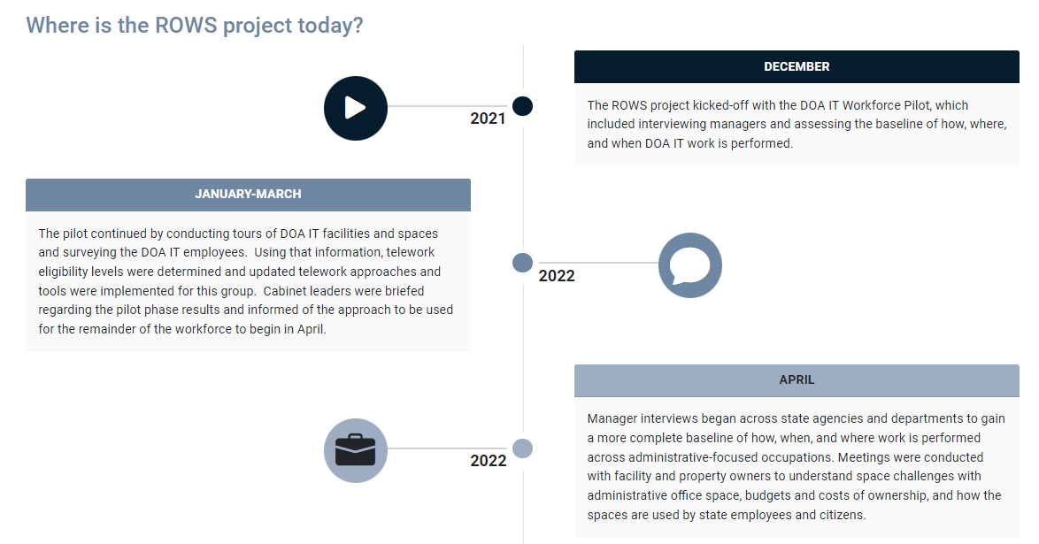
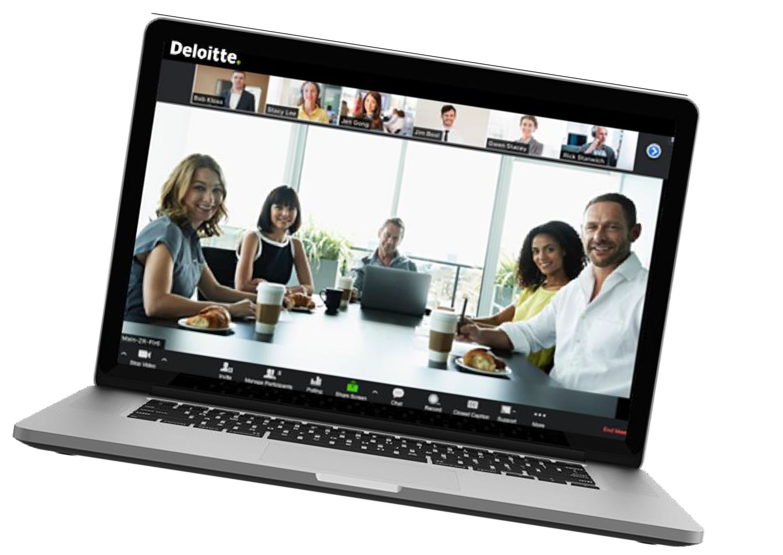
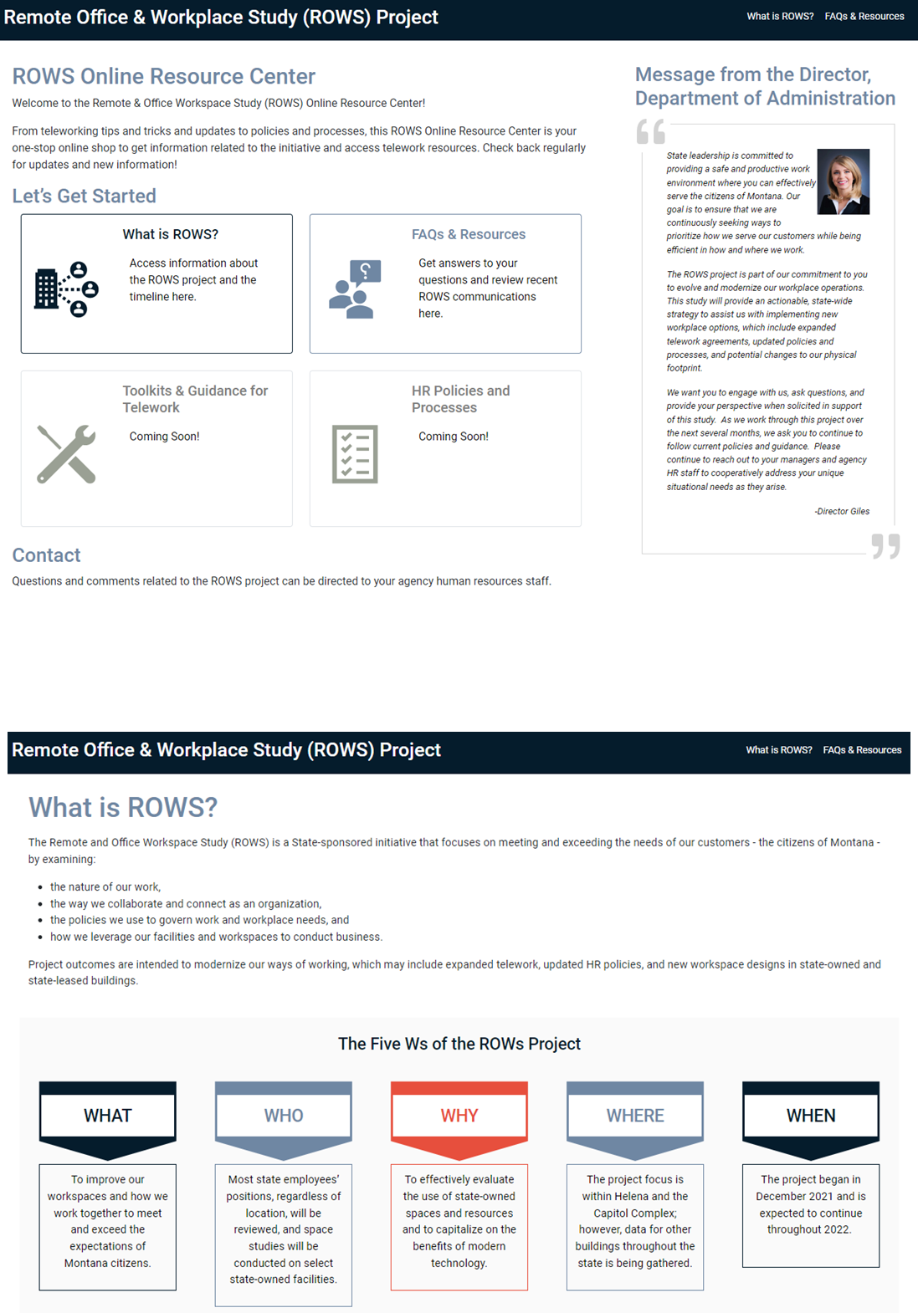
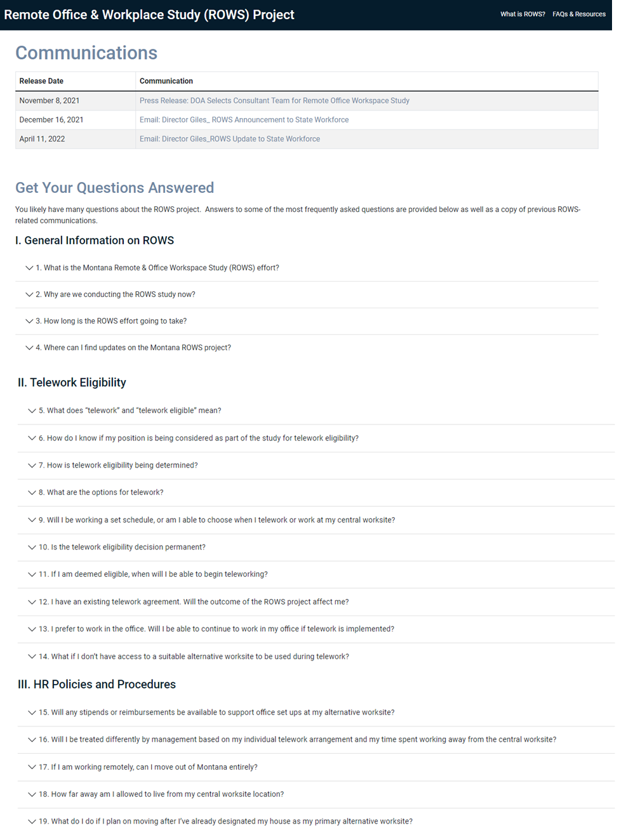
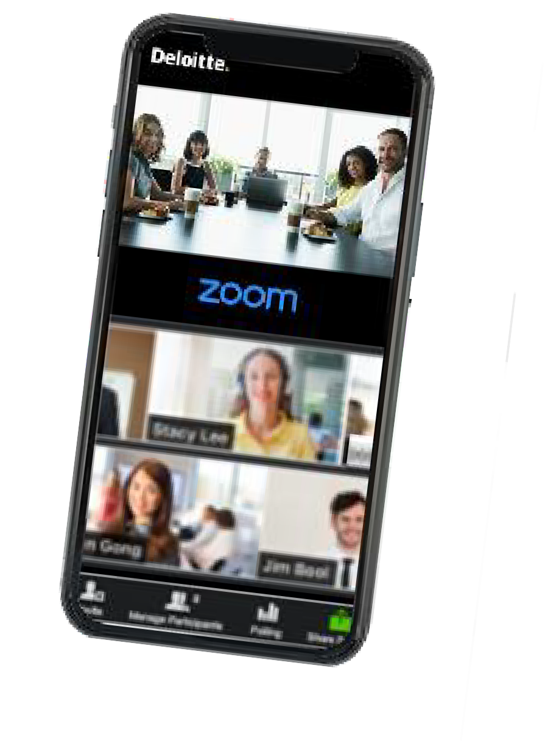


Additional resources for telework
Need additional help adapting to telework? Use the following resources to access technology software help, additional tailored ROWS guidance, and our Online Resource Center.
1
2
3
Technology Troubleshooting
ROWS Guidance
MT ROWS Online Resource Center
Scheduling Telework for Success
Managing Virtual Teams
Fostering a Strong Telework Culture
Virtual and Remote Work Best Practices
Access the Zoom Help Center, the Teams Help & Learning page, or the Microsoft Support site for self-service and live tech support.
Access the MT ROWS Online Resource Center (ORC) website for more about the Montana Remote and Office Workspace Study Project, telework policies, and other resources.

