Slide 1

Safety & Ergonomic Essentials for Remote Working

Slide 2


Safety Starts With You!
Safety is one of our core values here at the Department of Administration. We are committed to ensuring the safety of all employees, customers, and visitors and take all reasonable steps to provide and maintain safe working conditions.
-Director, John Lewis

Slide 3
Safety is Your Responsibility!
As DOA employees who are able to telework or preparing to work remotely, many of us likely do not have the same workstation setup at home that is available in our typical offices. A computer workstation at home may surround a laptop computer on a couch, bed, or kitchen table. As comfortable as some options may sound, using an improper workstation setup for an extended duration can cause awkward posture which can increase the risk for ergonomic related injuries (or musculoskeletal disorders such as tendonitis and carpal tunnel syndrome). It is important to set up your workstation as best you can to prevent injury regardless of where you might work.

Slide 4


Slide 5

SAFETY ESSENTIALS FOR REMOTE WORKING
LOCATION OF HOME WORKSTATION. Be consistent with where your designated home workstation is, a place where it is not noisy nd where it is easy to concentrate. It’s not just about productivity, but about setting up to successfully do meaningful work SAFELY!
FLOOR(S). Ensure that floors are clear and free from recognized hazards. Walkways and doorways are unobstructed and free from tripping hazards.
FIRE SAFETY. All portable heaters (if applicable) are located away from flammable items. Designated home workstation is kept free of trash, clutter and flammable liquids.
ELECTRICAL SAFETY. Electrical outlets are in good condition, no exposed/damaged wiring. Computer equipment is connected to a surge protected (recommended). Power cords, extension cords and all other electrical cords are secured under designated workstation, away from heat sources and not daisy chained together. All equipment is turned off when not in use.
SCHEDULE. Set a schedule and stick to it. Working designated hours, and then stopping when those hours are up, will give your brain time to work and time to rest. While working remotely does mean that there is added flexibility with your personal life schedule, it’s best to stick to a schedule where you can be productive, get your work done and call it a day when work hours are up.

Slide 6

WORKERS’ COMPENSATION & COVID-19
Q: WHAT IF AN EMPLOYEE FALLS ILL BECAUSE OF THE NEW CORONAVIRUS, IS THAT COVERED UNDER WORKERS’ COMPENSATION INSURANCE?
A claim for a coronavirus infection may be compensable (accepted) if the employee can prove that the disease was contracted in the course and scope of the employment. That means the employee must establish by objective medical evidence that the employee has been diagnosed with COVID-19 disease and must establish by a preponderance of the evidence (more probable than not) that the cause of the infection was due to an exposure at work. That proof will likely have to be established by proof that the infection was contracted through a known work-related exposure. For instance, if an employee falls ill from the coronavirus and a co-worker (also an official employee) then falls ill with COVID-19, the co-worker may be able to establish that the illness was due to contact with the other infected employee at the workplace and have a compensable claim. The first employee who fell ill will have to establish that the illness resulted from a workplace exposure, such as an infected customer as opposed to a community exposure.

Slide 7
WORKERS’ COMPENSATION & COVID-19
Q: WHILE EMPLOYEES ARE WORKING FROM HOME AND AN EMPLOYEE TRIPS OVER A DOG WHILE TAKING A WORK-RELATED TELEPHONE CALL, DOES THAT RESULT IN A COVERED WORKERS’ COMPENSATION INSURANCE CLAIM?
Under those facts, the claim will likely be compensable similar to a trip and fall that occurs while at your place of work. Remote employees present challenges for employers given that the employee’s home becomes the workplace. Workplace safety becomes more difficult, as does accident investigation. It is prudent for employers to establish specific work hours for remote employees as well as requiring timely reporting of accidents for the protection of both, the employee and the employer.

Slide 8
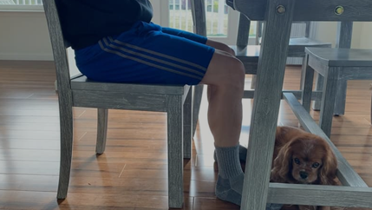
ERGONOMIC ESSENTIALS FOR REMOTE WORKING
USE A GOOD CHAIR (if possible). If you don’t have a good chair, and your back is not adequately supported, add pillows for back/leg support. If you don’t have a pillow, you could also roll up a towel for the same effect. Your knees should extend beyond the edge of your seat and your thighs are parallel to the floor.
RAISE YOUR CHAIR (most kitchen tables and desks are too high). Use a pillow as a seat cushion if needed. If you don’t have a pillow, you could also fold up a towel for the same effect.
SUPPORT YOUR FEET on a phone book, step stool, etc., if they don’t firmly touch the ground while sitting.

Slide 9
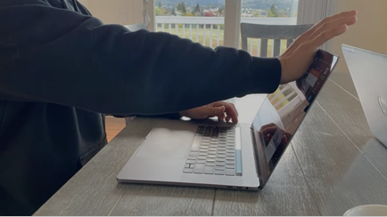
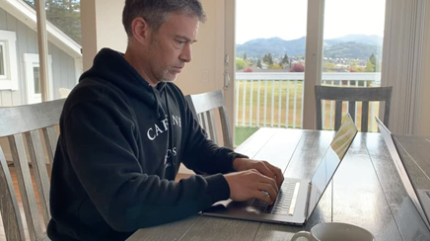
ERGONOMIC ESSENTIALS FOR REMOTE WORKING … CONTINUED…
MAINTAIN A GOOD POSTURE. If sitting, try to ensure that the small of your back is supported, your shoulders are relaxed (not slumped, not elevated), and that there is no unwelcome pressure on the back of your knees. If standing (e.g. at your kitchen worktop), keep your legs, torso, neck and head approximately in line and vertical – don’t slouch, lean or twist to the side.
LAPTOP/MONITOR PLACEMENT. Place the monitor(s) directly in front of you, about an arm's length away. The top of the screen should be at or slightly below eye level. Look straight ahead (not down or sideways) at your monitor. Your monitor height should be a height that you can look at with your neck straight, not bent. The top third of the screen should be positioned at or below eye level. For most people, that means you need to elevate the monitor. To achieve this you can use books, boxes, etc.

Slide 10
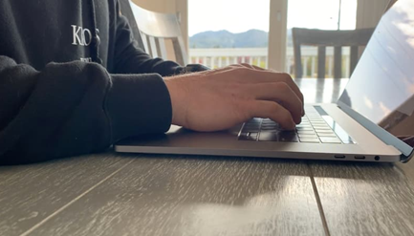
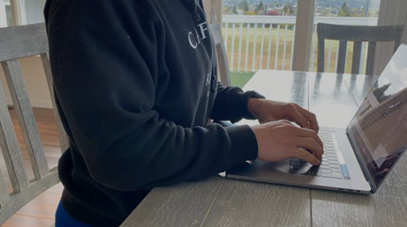
ERGONOMIC ESSENTIALS FOR REMOTE WORKING… CONTINUED…
KEYBOARD AND MOUSE. If available, use an external keyboard and mouse with your laptop and position the keyboard and mouse directly in front of you within easy reach. If you have a wireless mouse, place your mouse within easy reach and on the same surface as your laptop keyboard. While typing or using your mouse, keep your wrists straight, your upper arms close to your body, and your hands at or slightly below the level of your elbows. Use keyboard shortcuts to reduce extended mouse use. If possible, adjust the sensitivity of the mouse so you can use a light touch to operate it.
Your forearms should be parallel to the floor and approximately 90º from your upper arms.
Your wrists, neck & head should be in a relaxed neutral position, not angled up or down.

Slide 11
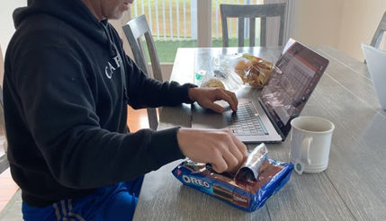
ERGONOMIC ESSENTIALS FOR REMOTE WORKING… CONTINUED…
PROTECT YOUR EYES. Dark mode is an option on apps, programs, and system preferences that darkens the background and control buttons, lessening contrast. In addition, place your monitor(s) so that the brightest light source is to the side. (Make sure to position your screen away from bright windows and white walls). Use blinds or drapes on windows to eliminate bright light.
KEY OBJECTS. Keep key objects such as your telephone, stapler, printed materials close to your body to minimize reaching. Stand up to reach anything that you can’t comfortably reach when sitting.
TAKE MICRO-BREAKS. Just like any working environment, giving yourself breaks is incredibly important to let your brain and body relax. Change your posture often. It’s crucial that you vary your posture throughout the day, because sitting in the same position or chair all day can lead to back, neck and shoulder pain. Try to take breaks every 30 minutes for 3-5 minutes to get up, walk around, stretch.

Slide 12
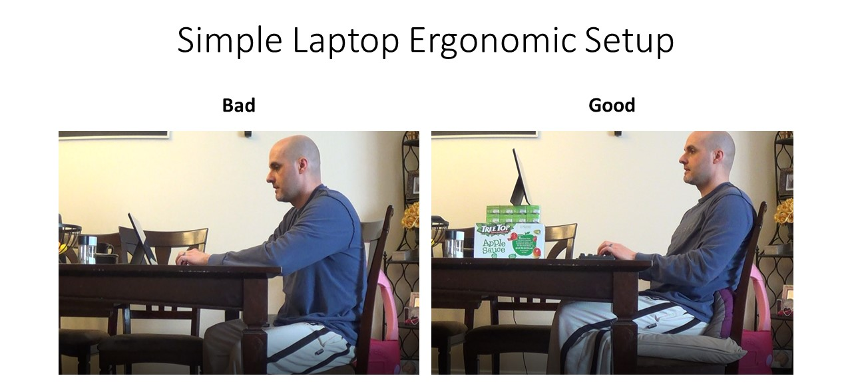
ERGONOMIC ESSENTIALS FOR REMOTE WORKING… CONTINUED…

Slide 13

ERGONOMIC ESSENTIALS FOR REMOTE WORKING… CONTINUED…

Slide 14
If you have any Safety | Ergonomics | Emergency Preparedness Questions, please feel free to contact me.
Thank you for your time and consideration! Be Safe & Stay Healthy!
Kirby Fugle
DOA Occupational Health & Safety Coordinator kfugle2@mt.gov
(406) 444-4162

